Slide 1
Relating Aerosol Profile and Column Measurements to Surface Concentrations:
What Have We Learned
from Discover-AQ?
Raymond Hoff
University of Maryland,
Baltimore County (UMBC)
hoff@umbc.edu
Notes:
What do we know now that we did not know in 2011 when the project began?

Slide 2
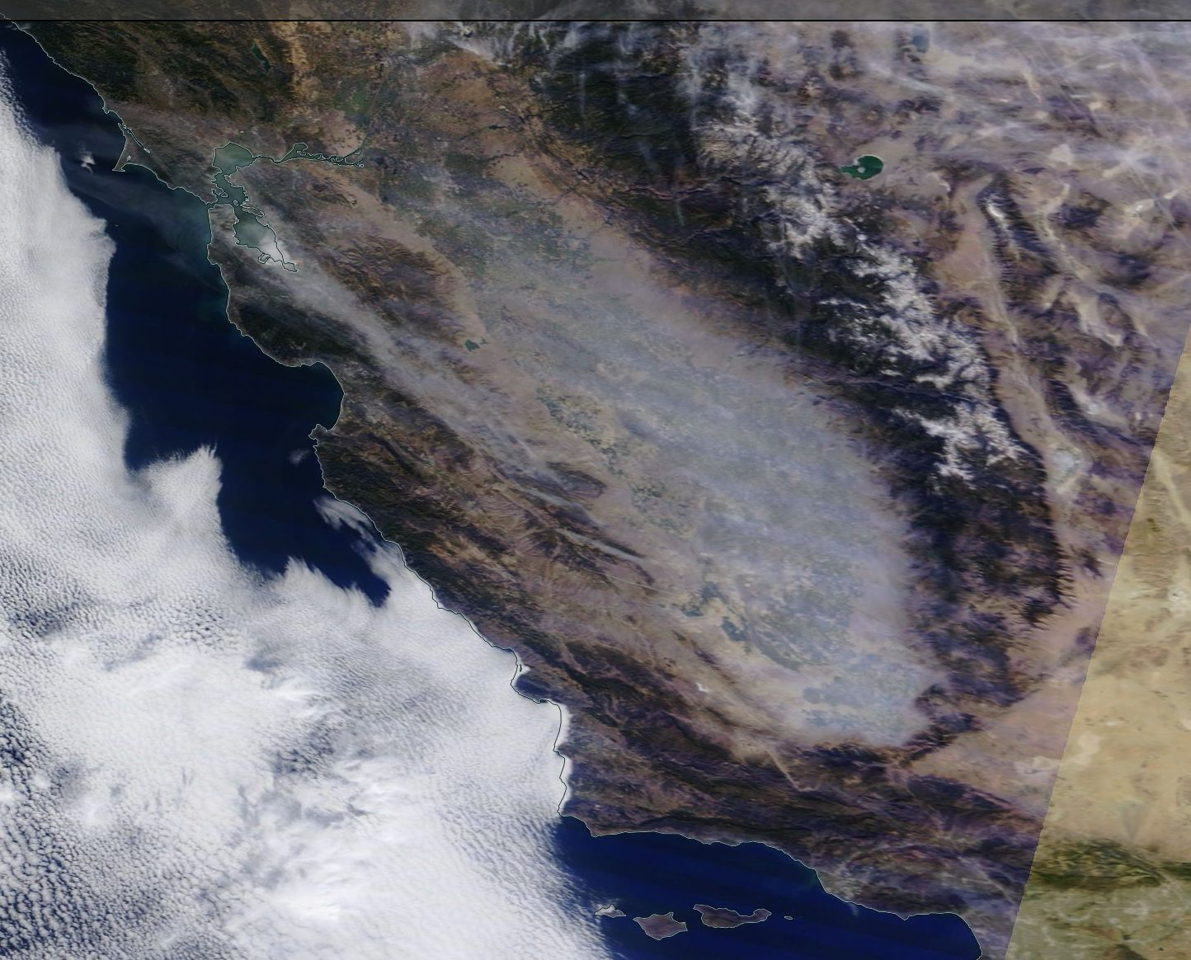
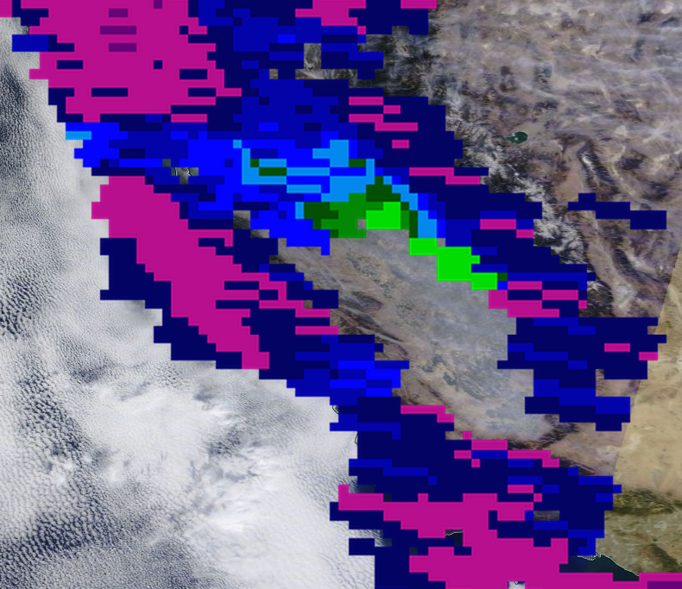
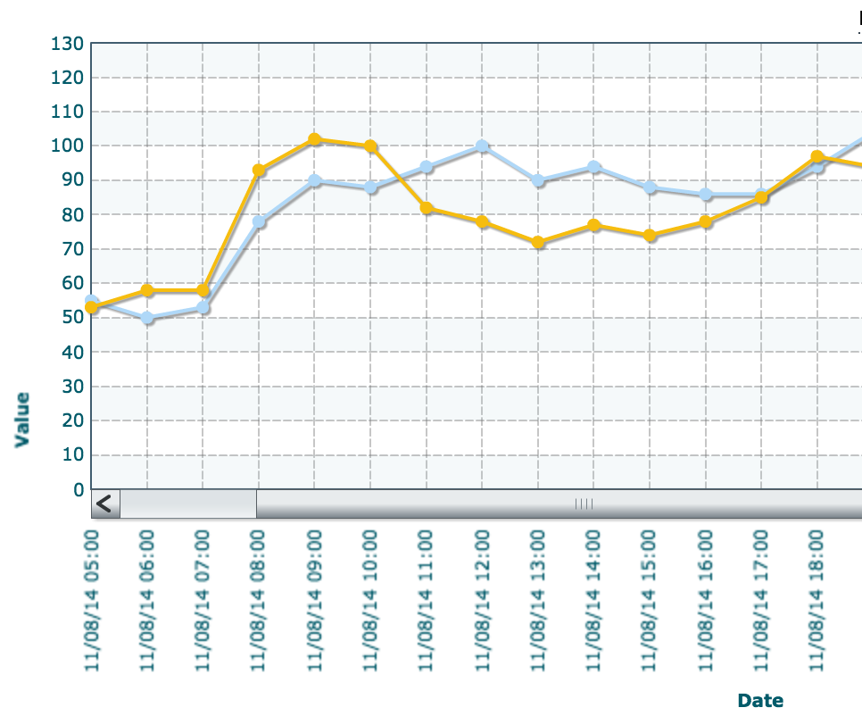
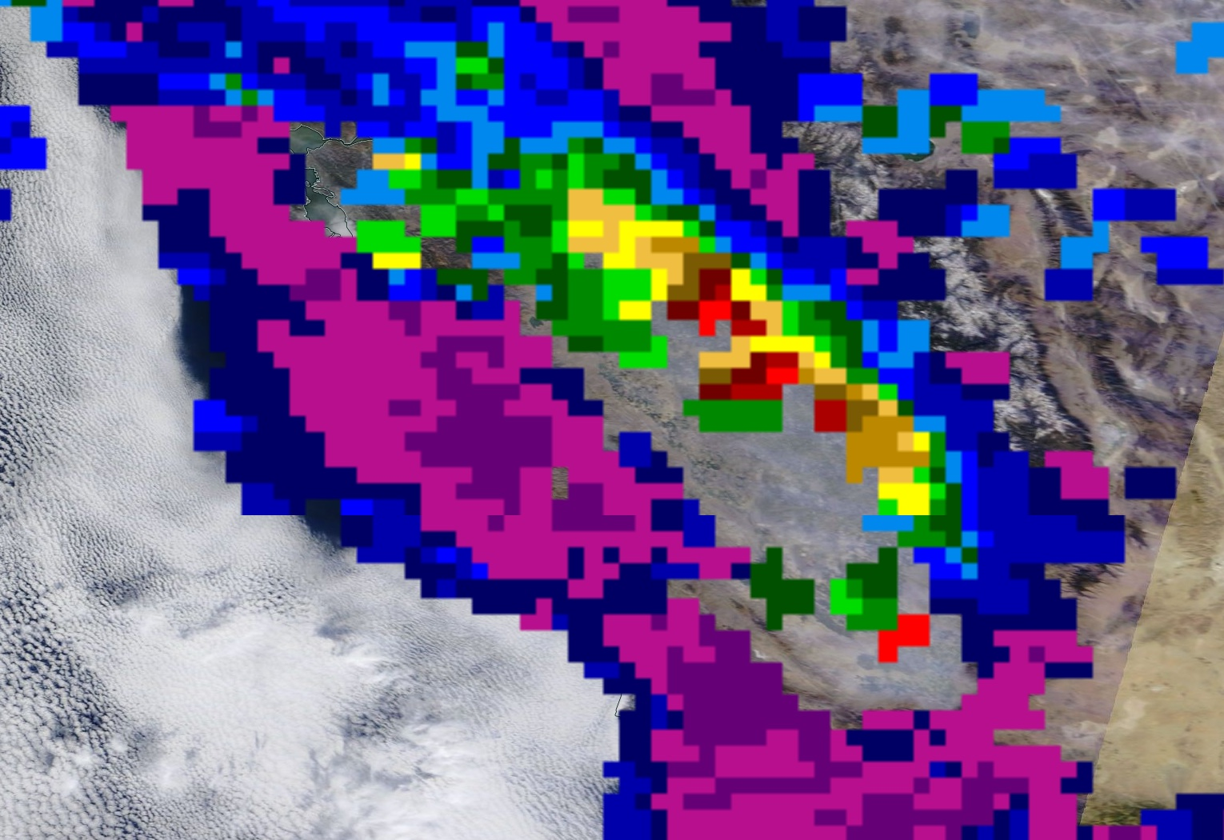
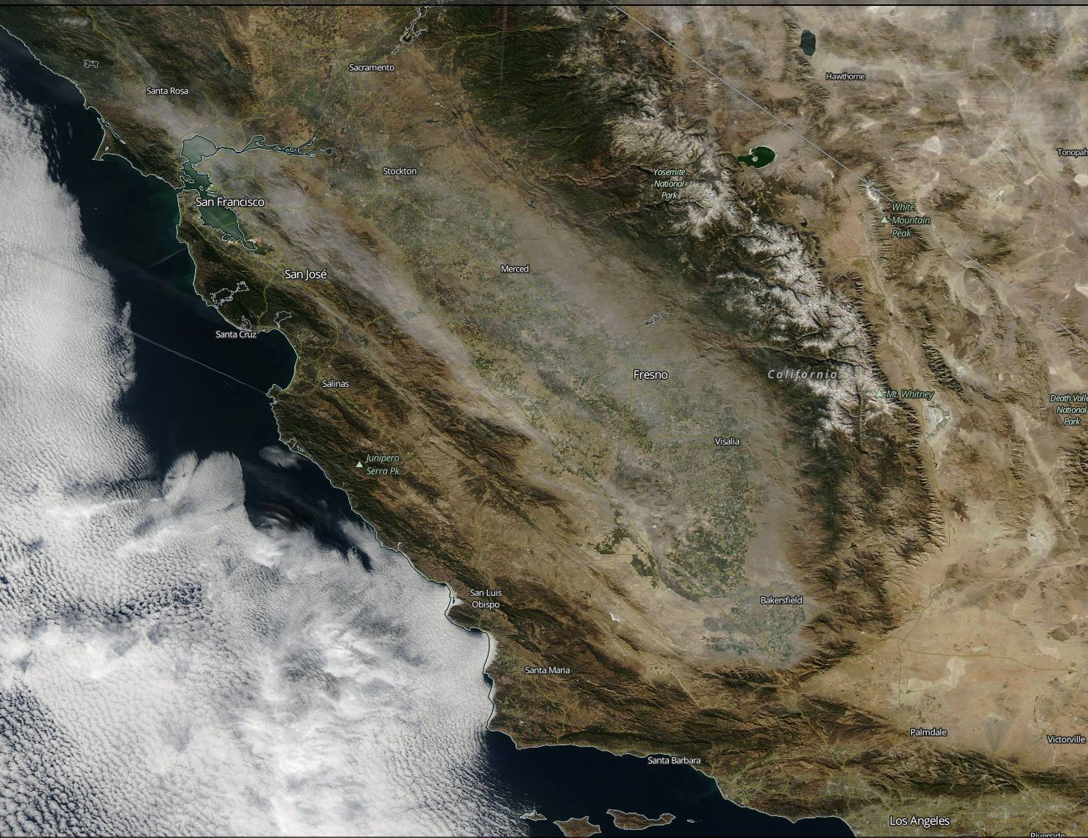
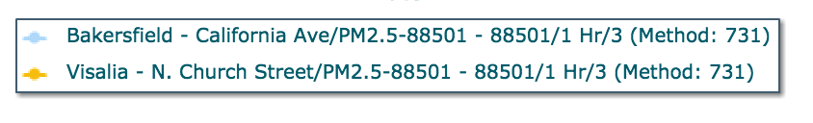
Investigation Rationale
Near-surface pollution is one of the most challenging problems for Earth observations from space…
20141108
Notes:
Three hours apart, the relationship between reflected radiance and PM2.5 varies quite a bit? Why?

Slide 3
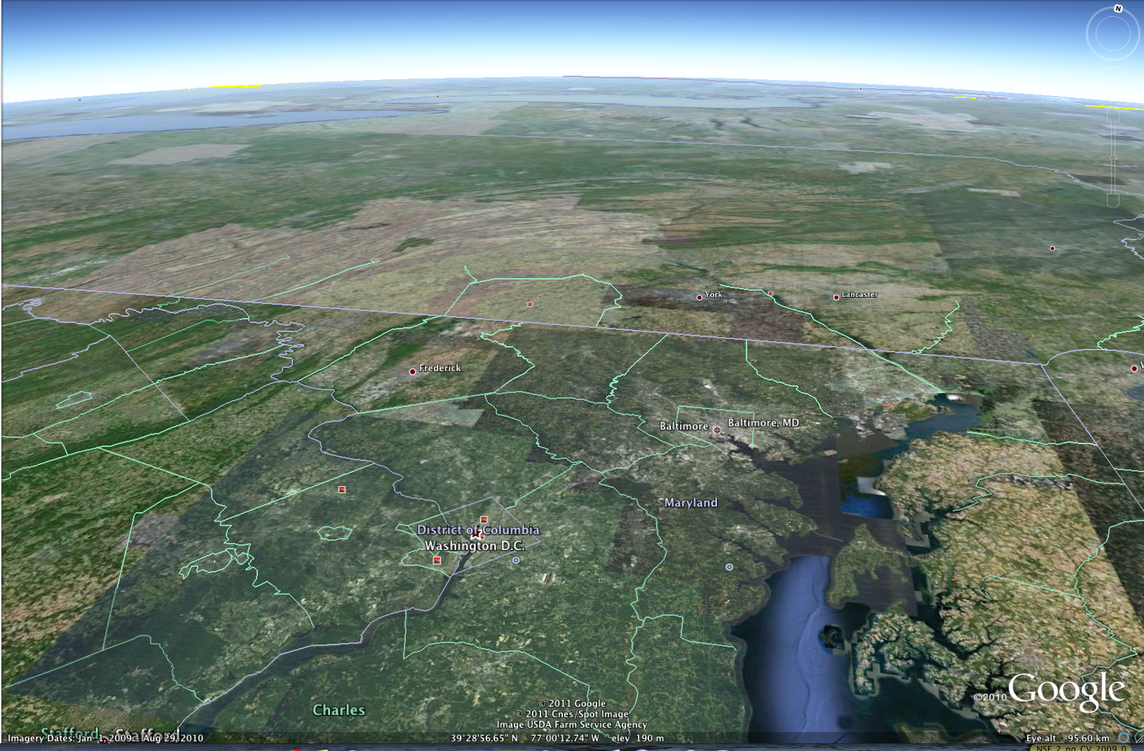
2009 Paradigm
Hoff and Christopher (2009)
α_{d}
PM_{2.5}
α₀
RH
WRF-CHEM?
PM is well mixed; extinction (α) varies with RH and height; clouds at LCL
PM_{2.5} = AOD / [f(RH) • SEC • PBLH]

Slide 4
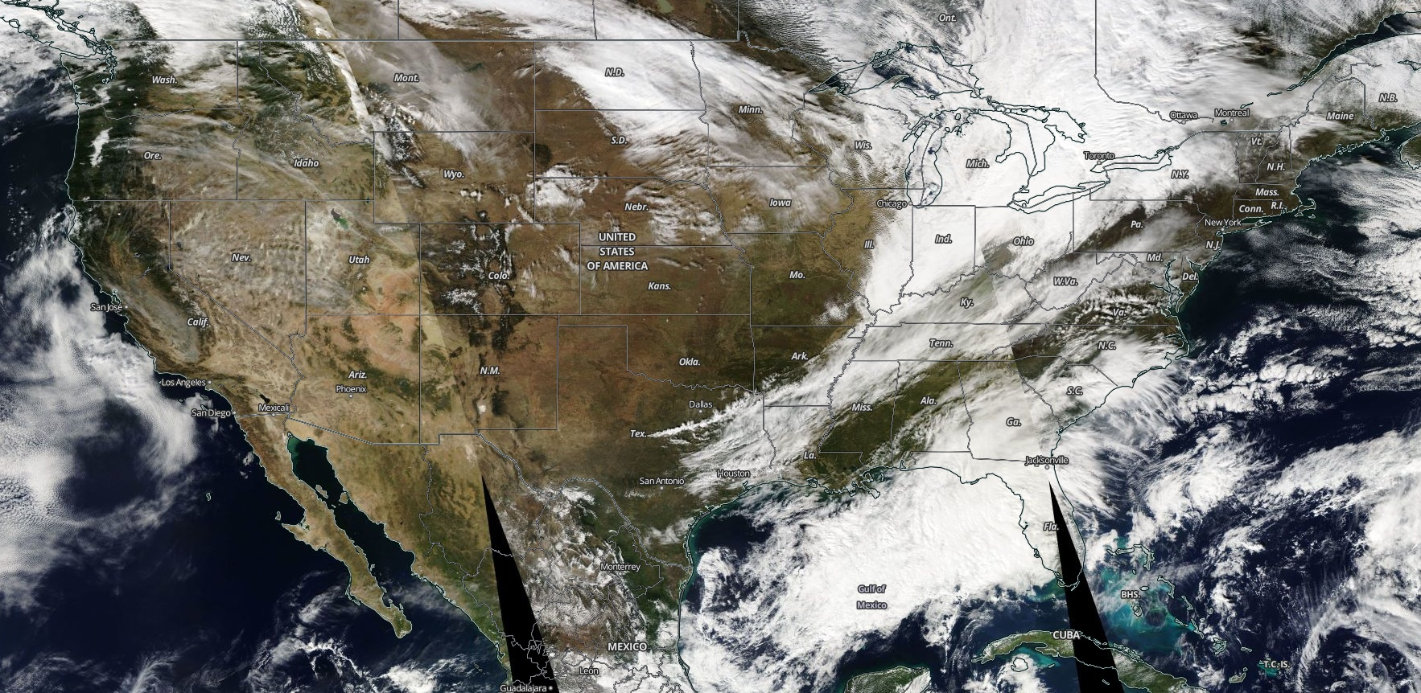
DISCOVER-AQ Locations
Colorado 2014
Balt.-Wash
2011
California 2013
Houston 2013
Aerosol problems are quite different

Slide 5
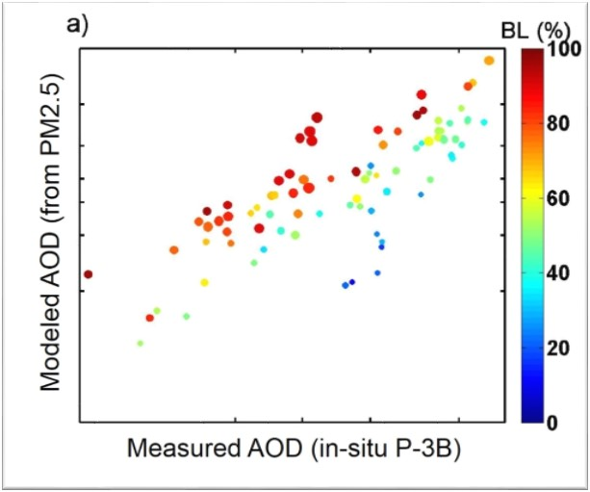
In Situ (LARGE) AOD-to-PM in Maryland
  A simple model using PM_{2.5} and hygroscopicity measurements can reproduce AOD in a well-mixed BL (red dots)
  Deviates for lofted layers (blue dots)
  Crumeyrolle et al., ACP 2014
  In-situ aerosol hygroscopicity model (gamma) yields consistent ambient extinction profiles compared to remote-sensing results from HSRL
  Water contributed up to 43% to AOD in the region
  Ziemba et al., GRL 2013

Slide 6

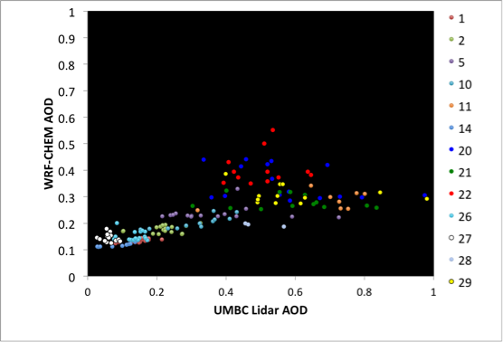
2013 Hoff AGU Paper
WRF-CHEM underestimates AOD on average
Midday PBLH is ok but PBL AOD is underestimated
  RH accuracy is an issue - growth model wrong?
  insufficient secondary aerosol?

Slide 7
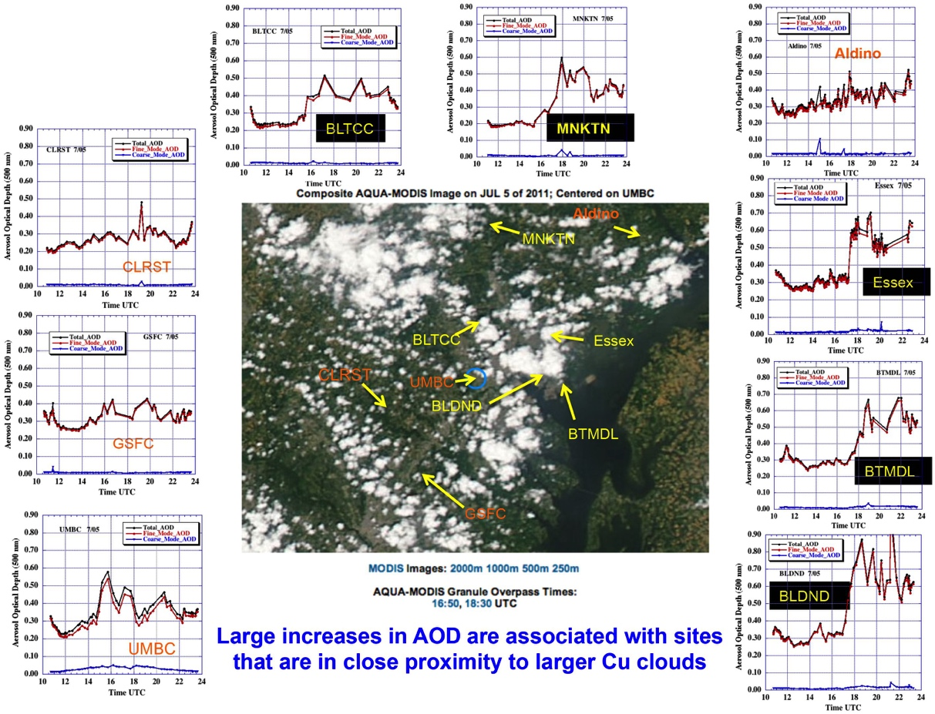
Baltimore-Washington
Eck et al, 2014
Schafer et al. 2013

Slide 8
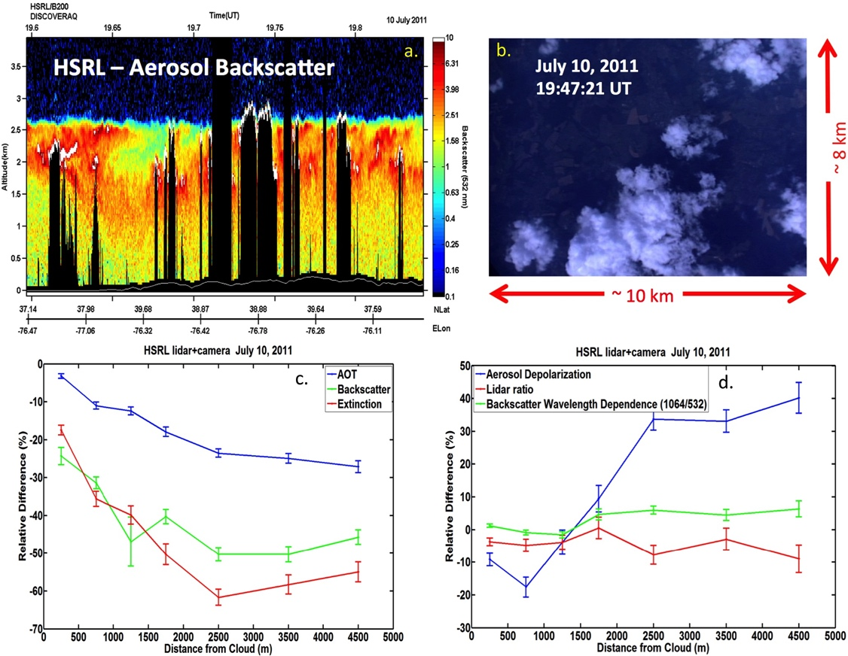
More than Koren’s “Silver Lining”

Slide 9
It is not just RH or f(RH)
Particle number also increases as you approach cloud base from below
Eck suggests that there is new particle formation below cloud base, perhaps organic in nature
Work is consistent with Hennigan’s earlier surface work showing SOA formation is RH dependent and SOA processing occurs in the vicinity of clouds

Slide 10
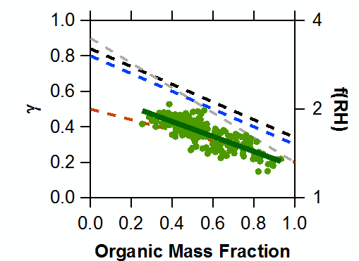
In Situ AOD-to-PM in Maryland & California
Maryland:
Aerosol composed primarily of organics and ammonium sulfate
Hygroscopicity driven by organic mass contribution
Consistent vertical distribution of aerosols with haze layer heights of ~ 7000 ft (2km)
Hygroscopicity (ɣ)
California:
Aerosol composed primarily of ammonium nitrate in a very shallow BL (~2000 ft or 600 m)
Deeper boundary layer on February 4 & 6
AOD-to-PM based on in situ measurements of extinction and composition from a particle-into-liquid sampler (PILS)

Slide 11
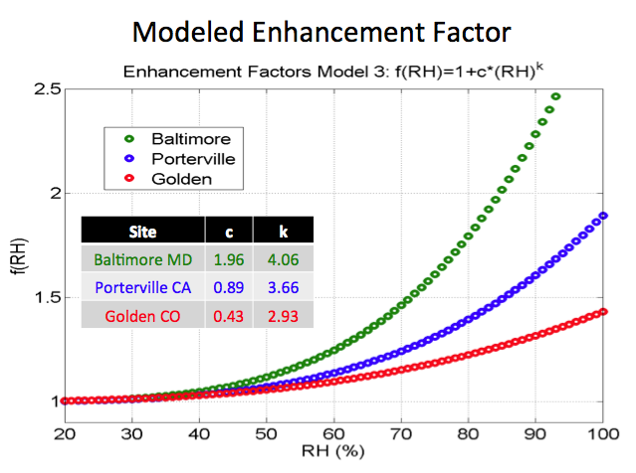
California: More than PBLH
Measured f(RH) shows
MD > CA > CO
MD
CA
CO
Orozco et al. Wed. Poster
A31C-3043

Slide 12
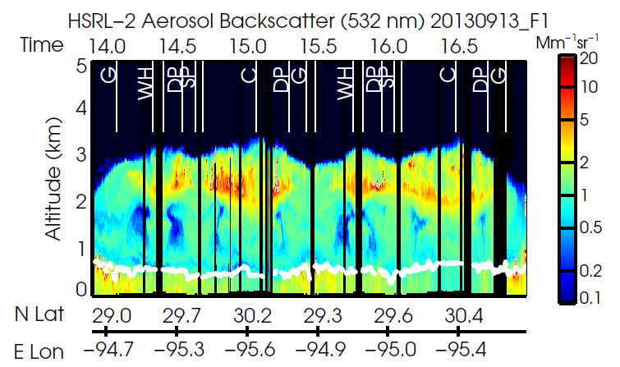
Everything is LARGE in Texas
Texas:
Variable aerosol vertical distributions largely due to the presence of aged smoke plumes transported from agricultural fires
HSRL measurements of the smoke are analyzed by Sharon Burton (presentation later in this session)
Smoke was aged in comparison to fresh agricultural smoke (Beyersdorf poster A53A-3187, Friday)

Slide 13
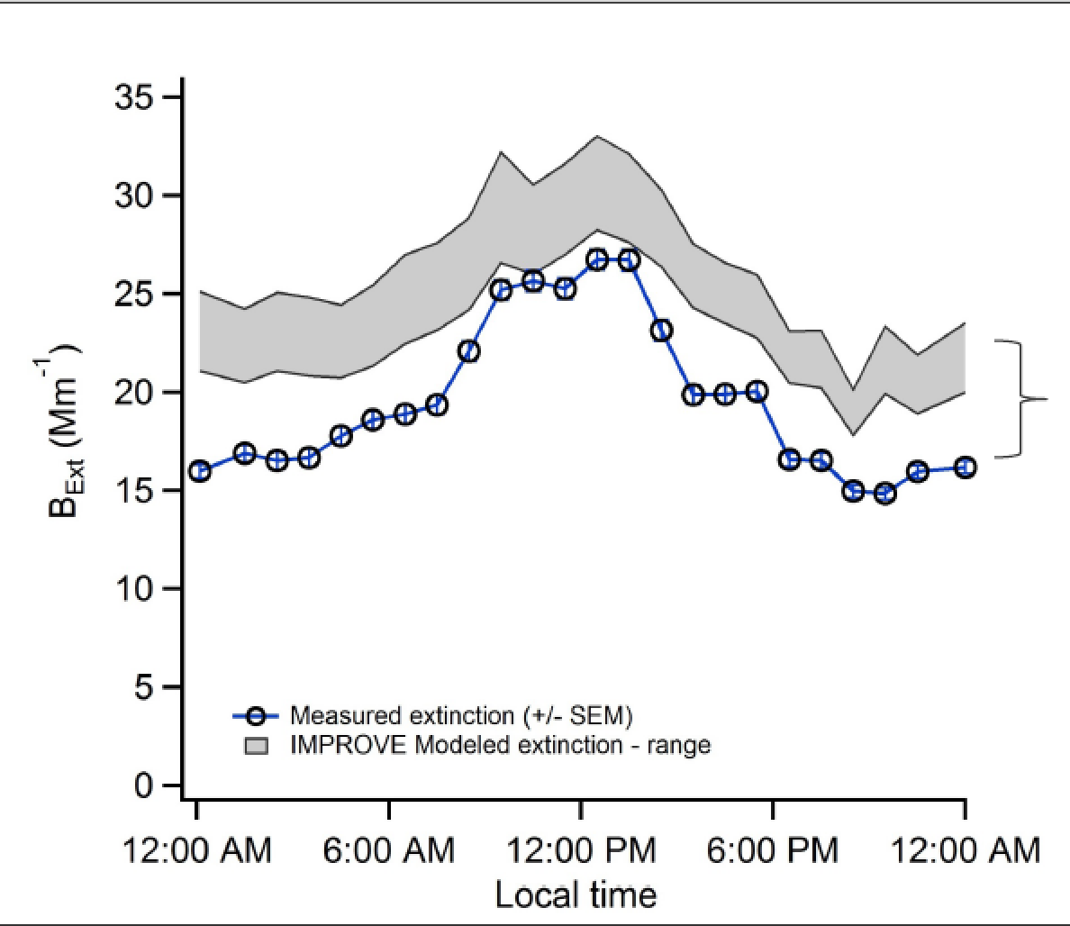
Colorado (Hennigan et al., 2015)
B_{ext} = 3 f(RH) (SO₄+NO₃) + 4 f(RH) OC
+1 Soil(Ca) +10 EC

Slide 14
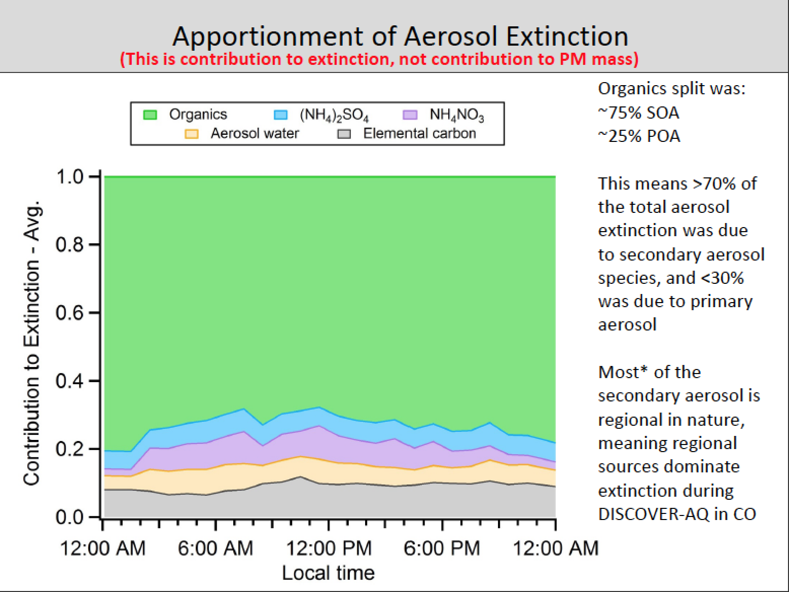
Colorado (Hennigan et al., 2015)

Slide 15
Take Away Message
You can teach old dogs new tricks
Humidity is important to AOD – PM2.5 but it is only part of the problem
The silver lining around clouds is wide
Organic aerosols do take up water and may be formed with an RH dependence – SOA….
We still are some way off from having a forecast model fix the AOD/PM2.5 relationship but the data exists from DISCOVER-AQ to better define the unknowns.

