Slide 1
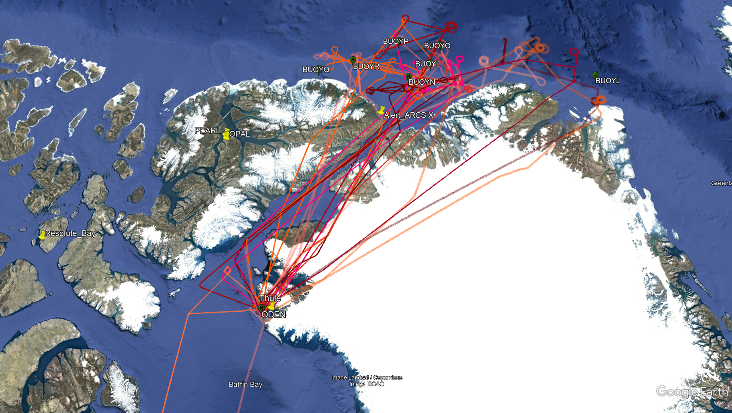
P3 Flight paths flown
ARCSIX 1 + 2

Slide 2
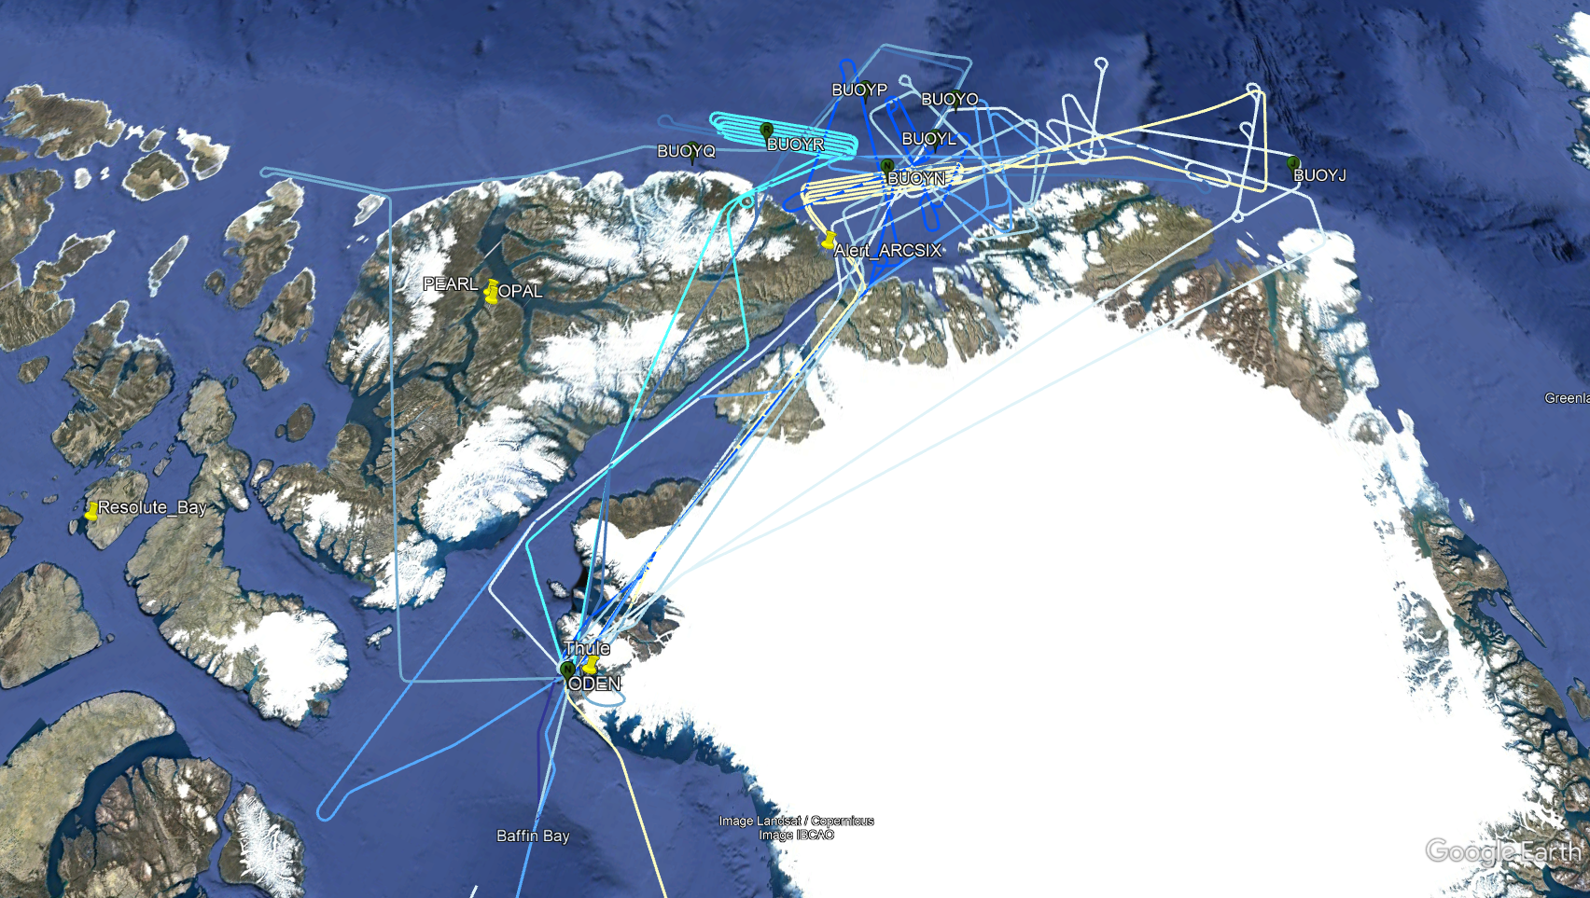
G-III Flight paths flown
ARCSIX 1 + 2

Slide 3
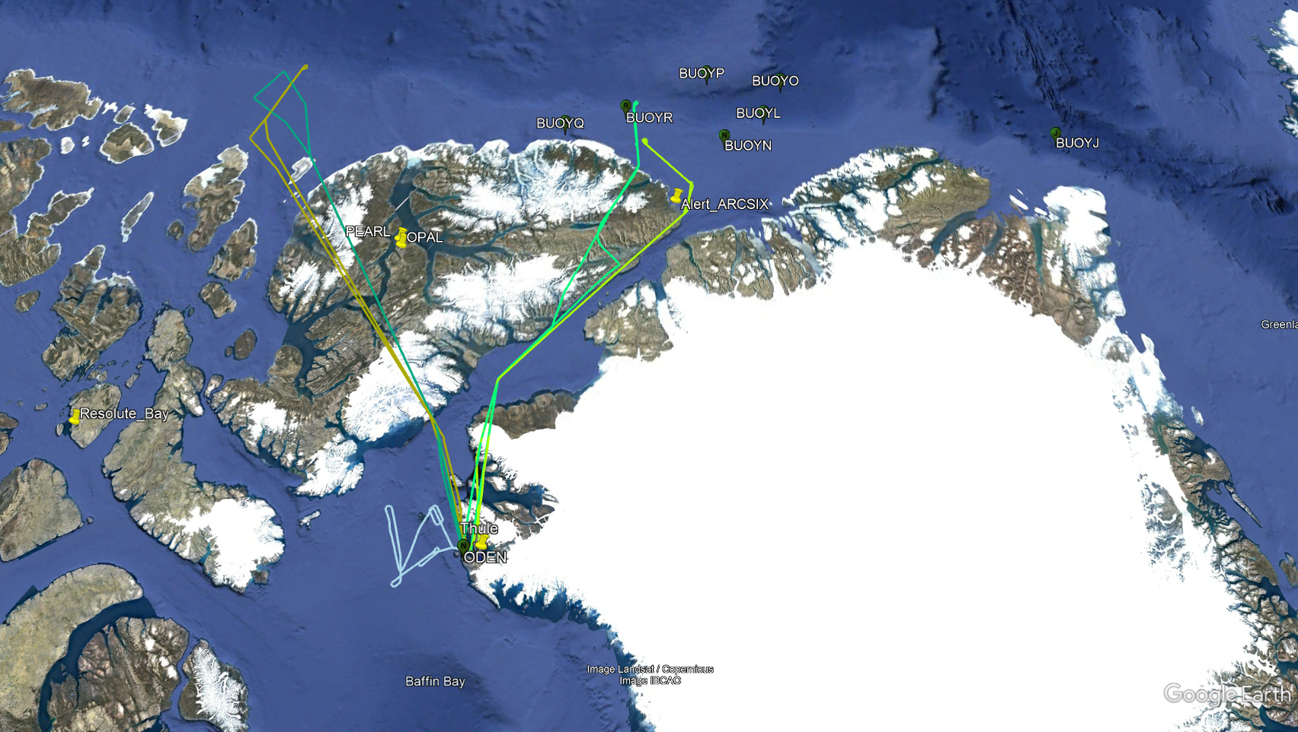
LearJet Flight paths flown
ARCSIX 1 + 2

Slide 4
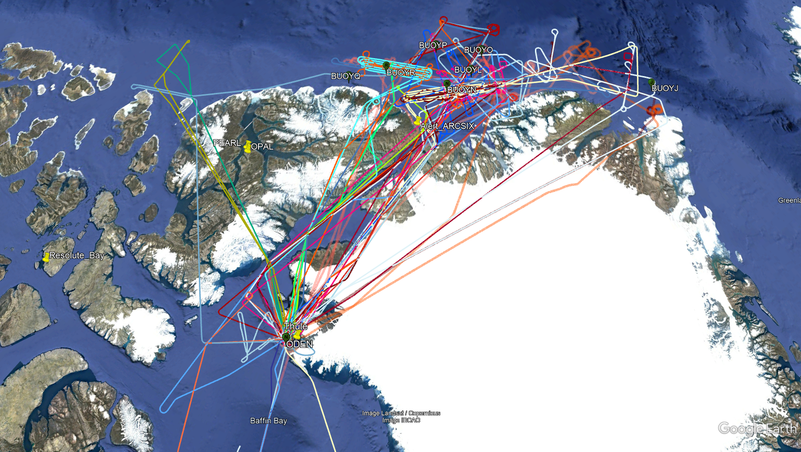
All Flight paths flown
ARCSIX 1 + 2

