Slide 1
Mission Registration Base Information Logistics
Earth Science Project Office
Jhony Zavaleta, Kent Shiffer, Steven Todorov

Slide 2
Introduction
Civilian Landing Permits
Website Registration
Osan Air Base
Access
Restrictions
Orientation
Lodging
Work and Lab Spaces
Aircraft Parking
Shipping

Slide 3
Civilian Landing Permit Deadlines
It was recommended to submit requests at least 60 days in advance. Deadline for all requests Nov 1, 2015. Requests include:
DD Form 2400 Civil Aircraft Certificate of Insurance
DD Form 2401 Civil Aircraft Landing Permit
DD Form 2402 Civil Aircraft Hold Harmless Agreement

Slide 4
ESPO Website Registration Timeline
Invitation & instructions to register for the deployment go out November 1. DUE DECEMBER 1

Slide 5
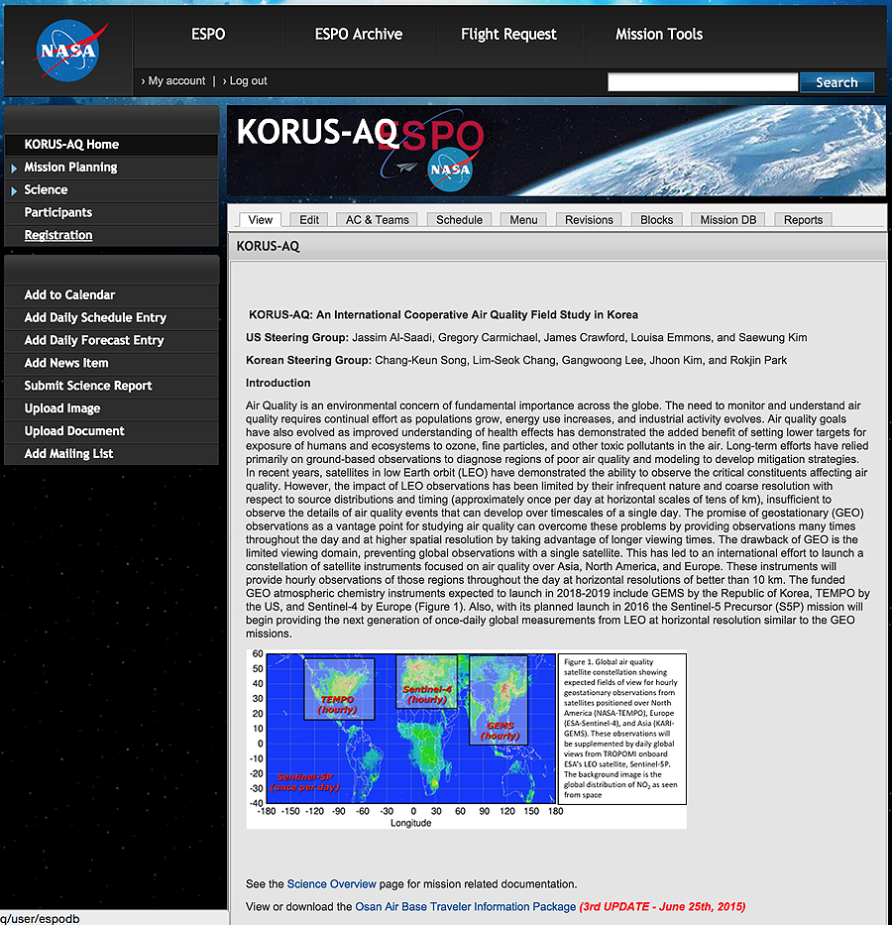
ESPO Website Mission Registration

Slide 6
ESPO Website Registration
Provide separate travel information for specific activities:
Integration
Armstrong Flight Research Center (AFRC) in Palmdale, CA
Deployment
Osan Air Base, Republic of Korea
De-integration
Armstrong Flight Research Center (AFRC) in Palmdale, CA
Dates should indicate arrival date and departure date at the site.
(NOT the departure and arrival date from your starting point)
Notes:
Confirmed, contingency…,

Slide 7
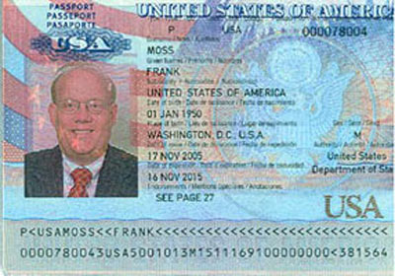
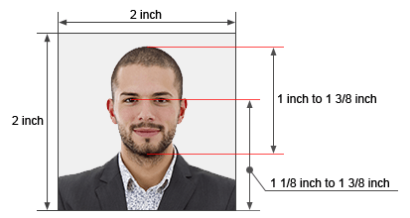
ESPO Website Registration
MUST upload requested photographs/scans (head/face - passport style)
2 inch = ~50mm

Slide 8
ESPO Website Registration
Information Required for everyone (as per USFK Form 37EK):
Full Name
Gender
Date and Place of Birth
Address & Phone number
Height
Weight
Hair Color
Eye color

Slide 9
ESPO Website Registration
Korean Nationals:
Affiliation (research institution, university, etc.)
Korean ID information: number expiration date
Upload scan/picture of KID document
If planning to bring a vehicle, include vehicle information:
Make, model, year
Registration number
Insurance policy number

Slide 10
ESPO Website Registration
Non-Korean personnel:
Scan of passport information page (US citizens)
Scan of Permanent Resident Card
Scan of US Visa page (as applicable)
Retired US military: No Osan ID card to be issued, notify ESPO, name will be submitted to DBIS.

Slide 11
ESPO Website Registration Invitations
You MUST receive an email invitation (to be linked to the mission.)
PI from each instrument can also add members to their team or send ESPO a request for an invitation.
Initial Invitations are good for 1 week only, one time use.
Password can be reset/requested at the registration page.
It is very important!

Slide 12
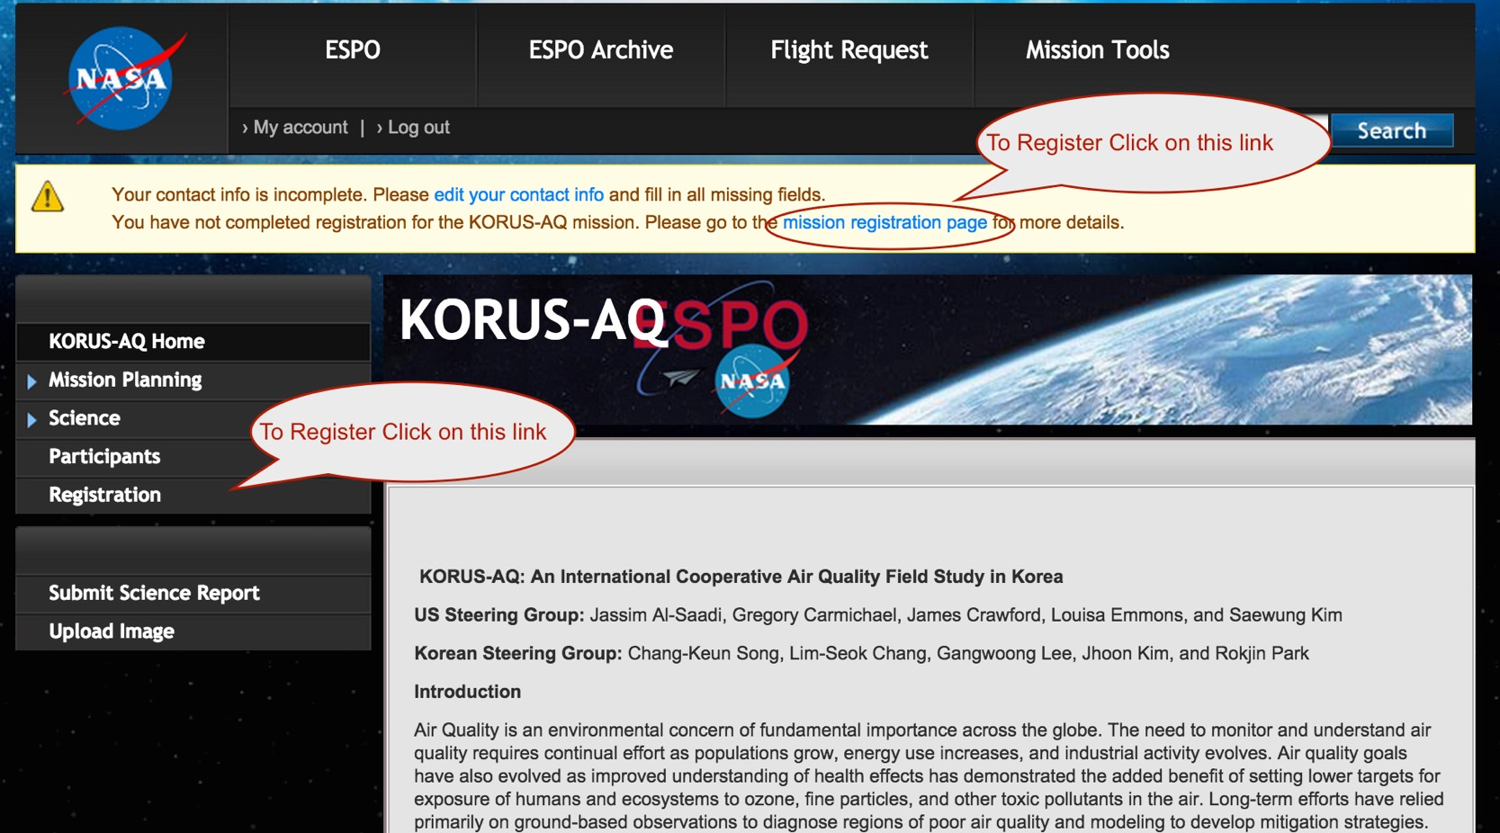

Slide 13
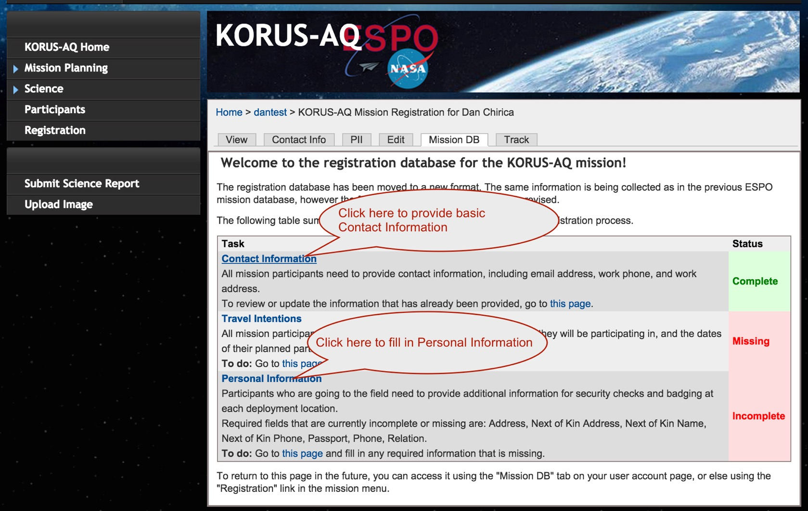

Slide 14
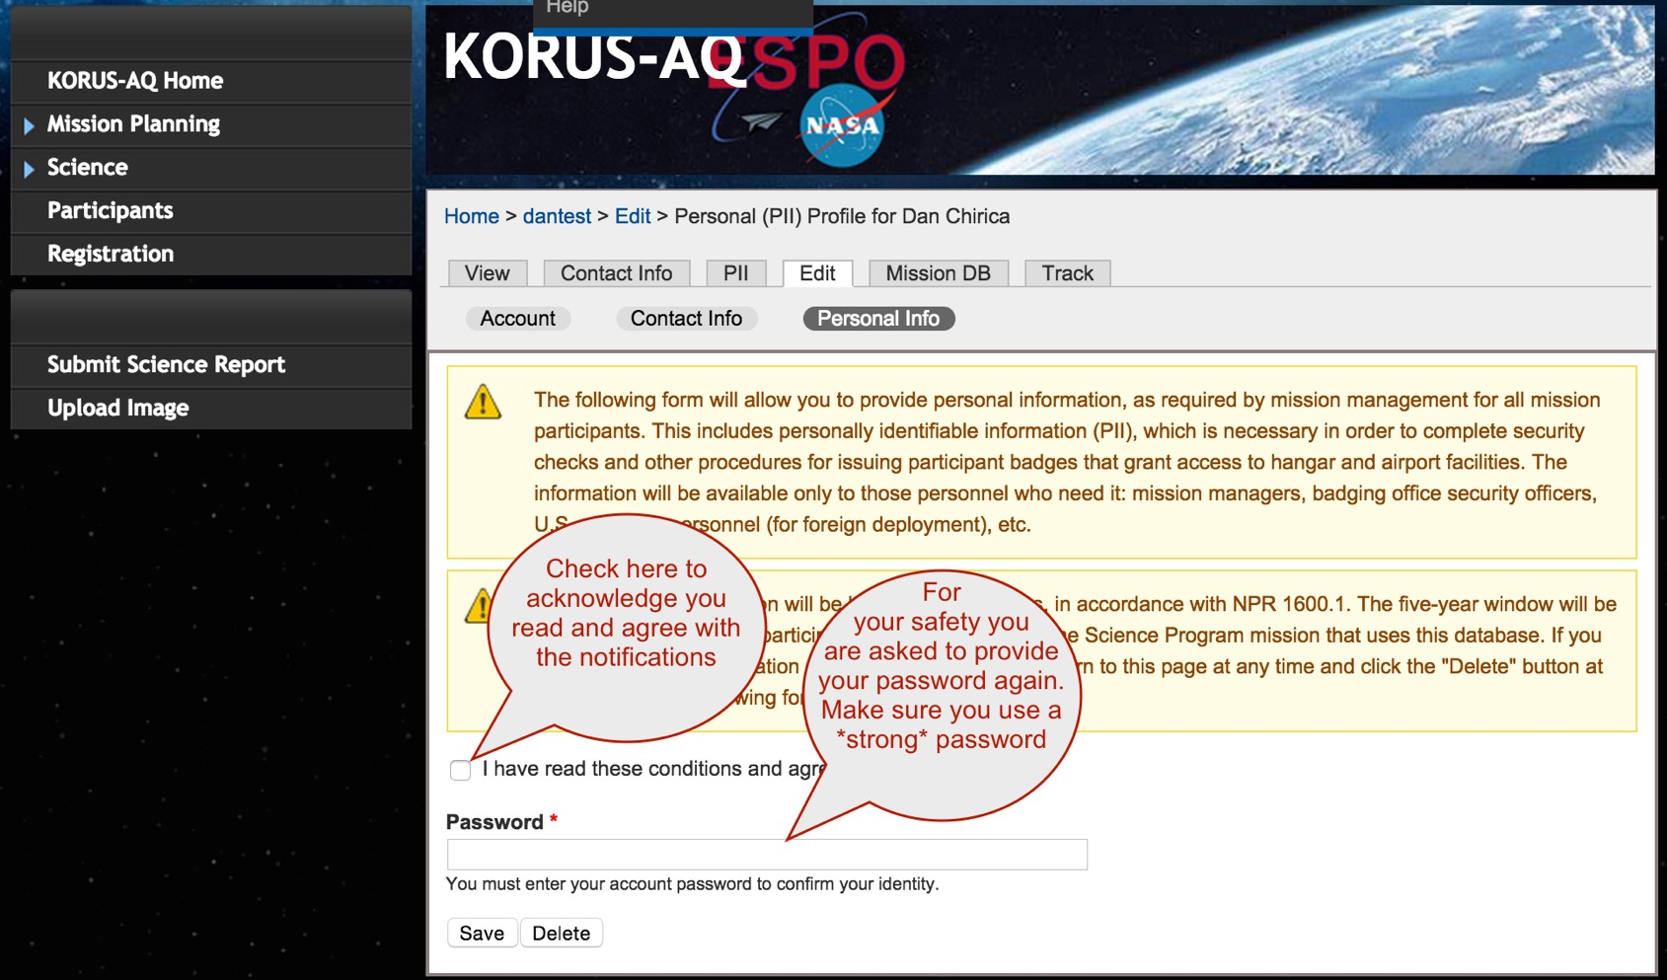

Slide 15
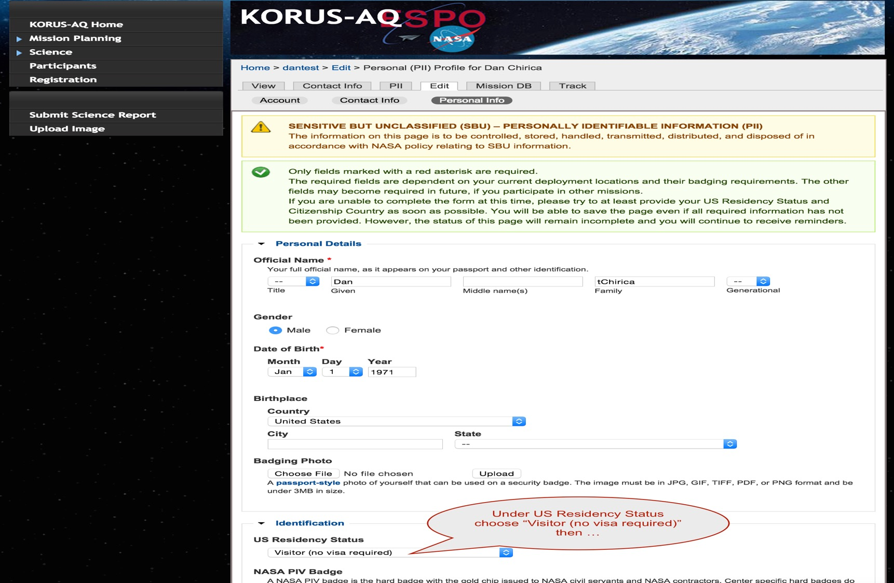

Slide 16
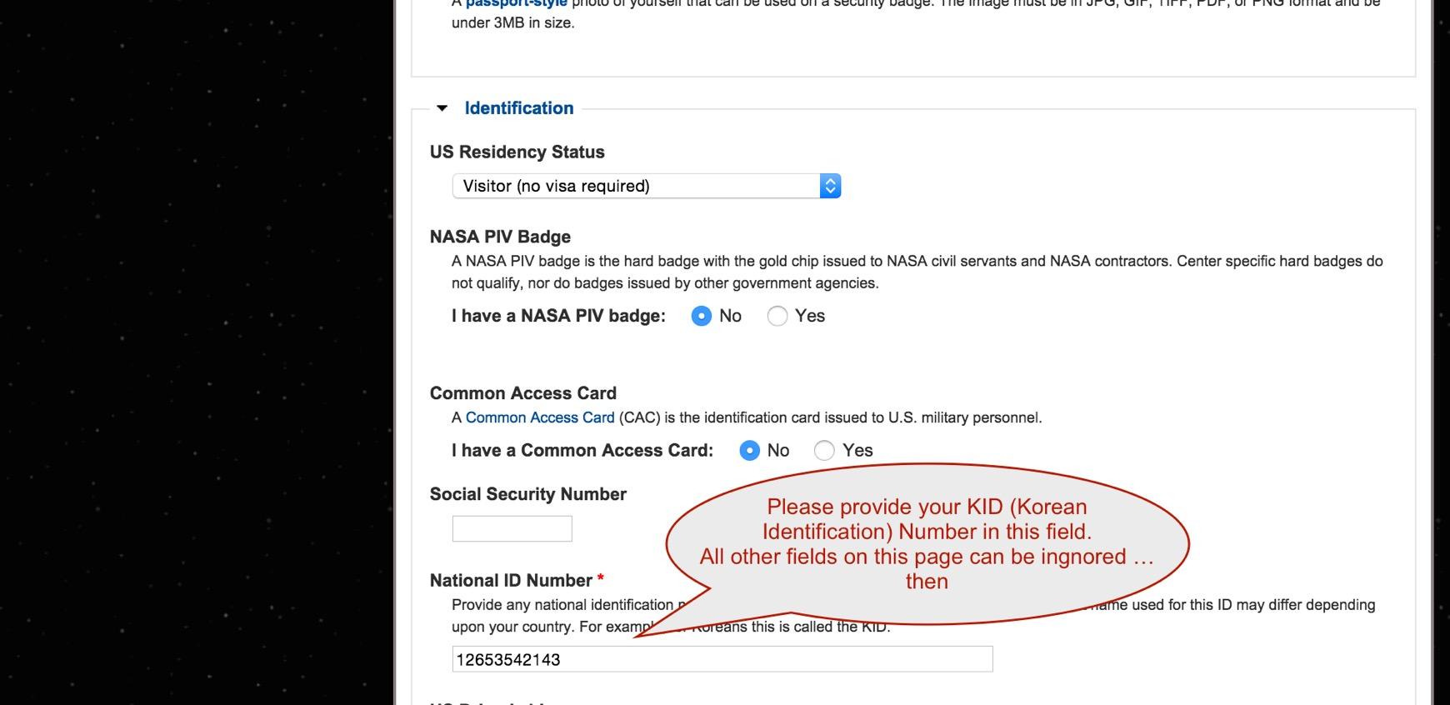

Slide 17
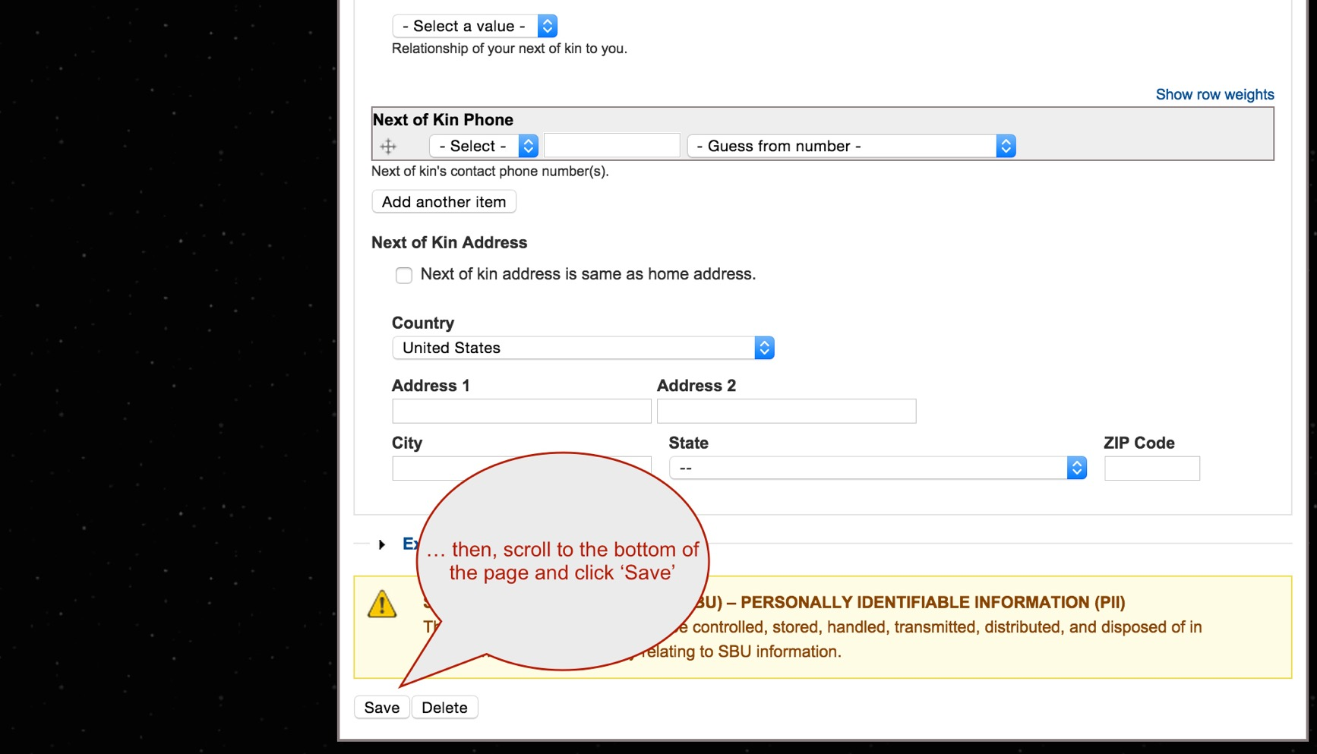

Slide 18
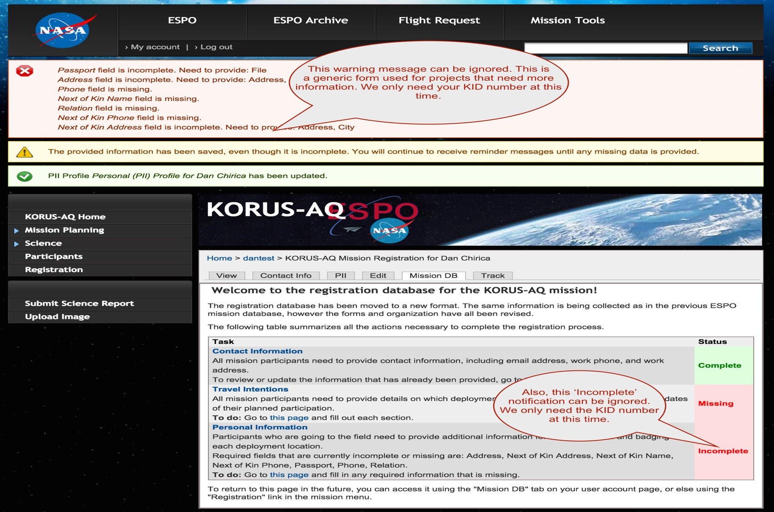

Slide 19
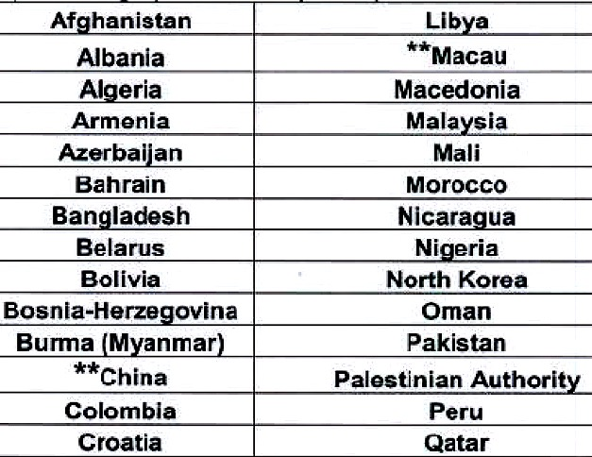
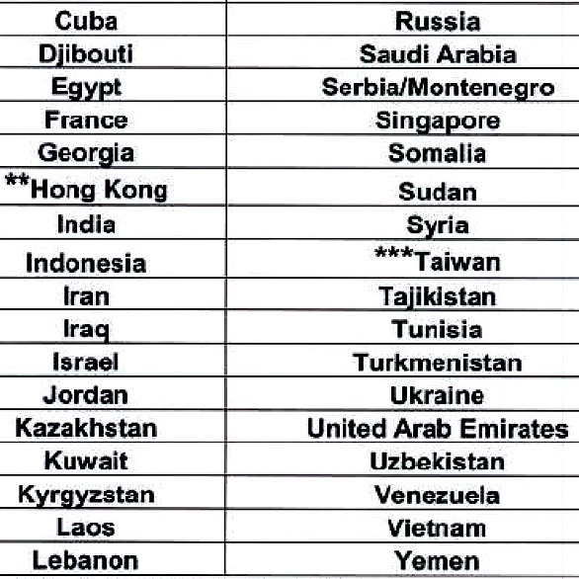
Citizens from Designated Countries
Notify ESPO NLT November 1st, 2015
Need to identify specific escorts no later than February 1st, 2016
Notes:
* As of 2009 for USFJ. No list provided by USAFK. This is a best guess.

Slide 20


Osan Air Base Access
Identification while on base:
Base Issued ID
KID /passport
Mission badge
Notes:
Authorized Entry List: is routed and approved 30 days in advance, last minute additions are highly discouraged and may not be approved in time.

Slide 21
Osan Air Base Access
US citizens can escort up to 3 people and one vehicle.
Citizens from Designated countries: must be escorted at all times and cannot stay on base.
ESPO will distribute a Traveler Information Package before the deployment (End of March, 2016). Check website for information.
Notes:
Authorized Entry List: is routed and approved 30 days in advance, last minute additions are highly discouraged and may not be approved in time.

Slide 22
Osan Air Base Restrictions
No Photography in the flight line or towards the runway. No photographing of military aircraft.
DCP escorted at all times
Always carry Identification: and proof of any special access/training as needed.
Last minute visitors:
Must be escorted at all times
No after hours
Cannot stay on base
No DCP
Add to database and notify ESPO
Notes:
Authorized Entry List: is routed and approved 30 days in advance, last minute additions are highly discouraged and may not be approved in time.

Slide 23
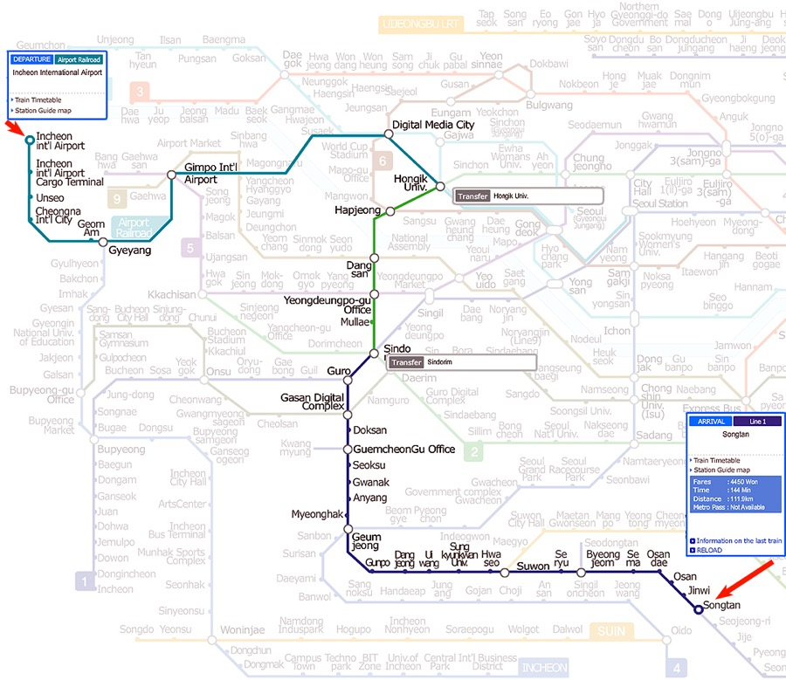
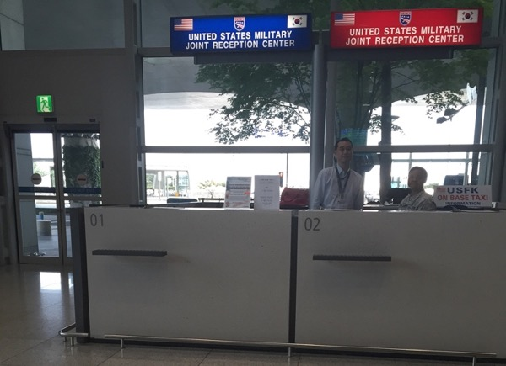
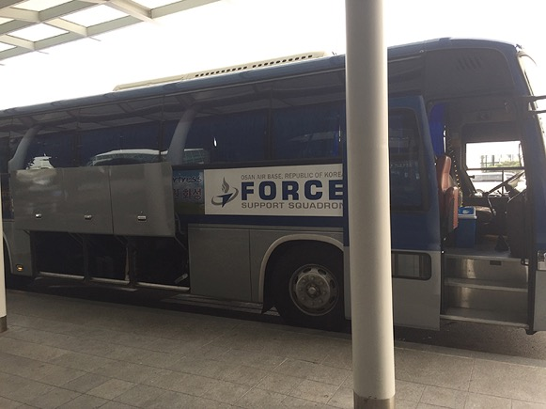
Transportation
From Airport to Osan AB
Bus Transportation
Metro
Taxi (not recommended)
Notes:
Each traveler is responsible for own travel arrangements. ESPO doesn’t provide transportation.

Slide 24
Transportation
On base (everything is within 1.5Km (1 mile) distance)
Privately owned vehicles are OK
Taxi (~3000 Won/~$3USD)
Walking
Bike
Off base: (See the orientation package)
Train
Bus

Slide 25
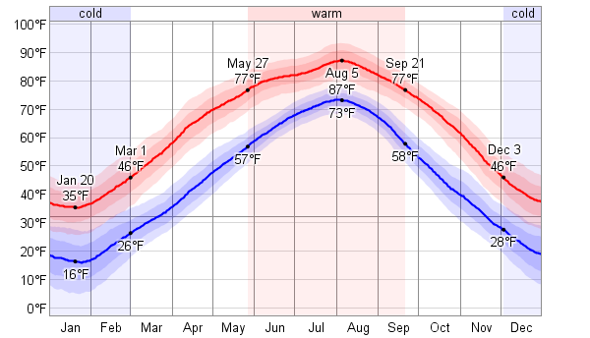
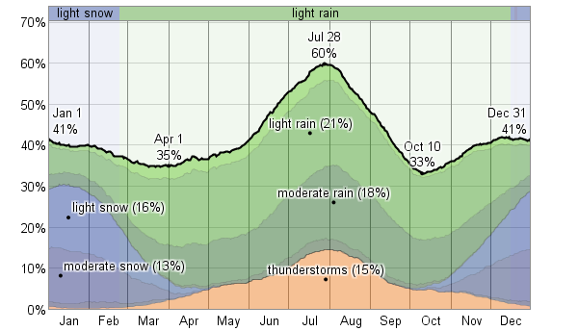
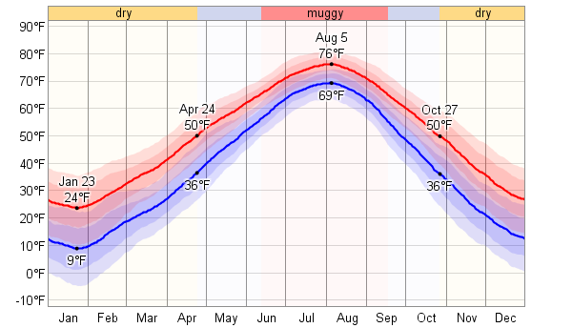
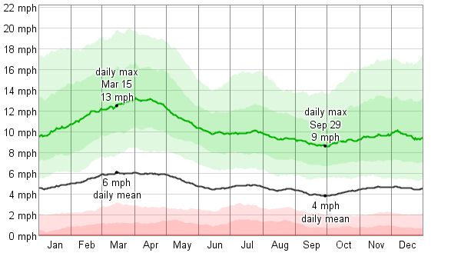
Osan AB - Weather Averages
Monthly Temperature Averages
Monthly Precipitation Averages
Monthly Humidity Averages
Monthly Wind Speed Averages

Slide 26
Lodging
On base: Turumi Lodge (150 rooms)
Rate: $60/night
Off base:
Contract hotels just outside the base
Rate: ~$85USD
Per Diem rates are different in each case.
Osan Air Base (Other):$77/$52
Off-base hotels (Pyongtaek City): $82/$63

Slide 27
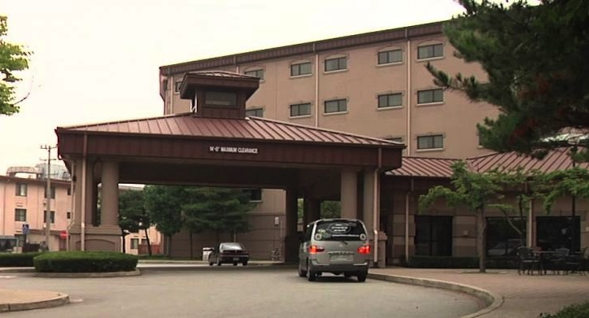

Slide 28
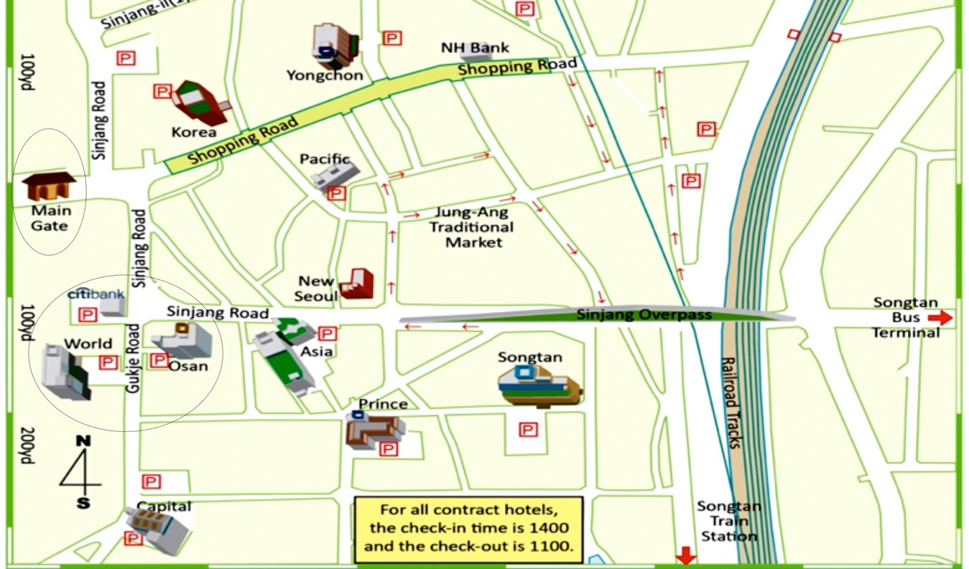

Slide 29
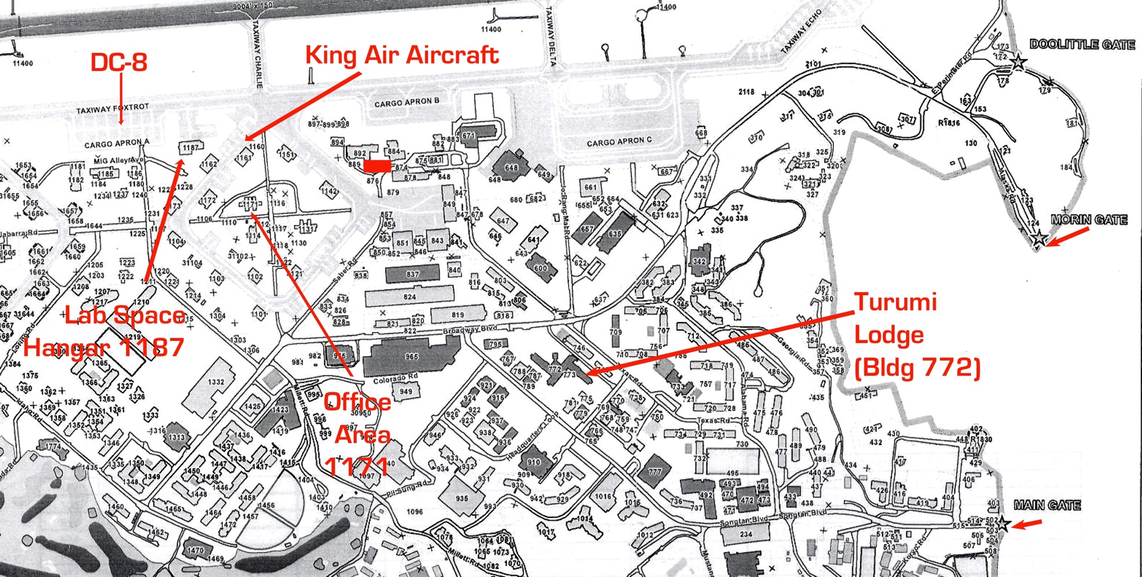
Notes:
Turumi lodge, Aircraft parking, office, lab

Slide 30
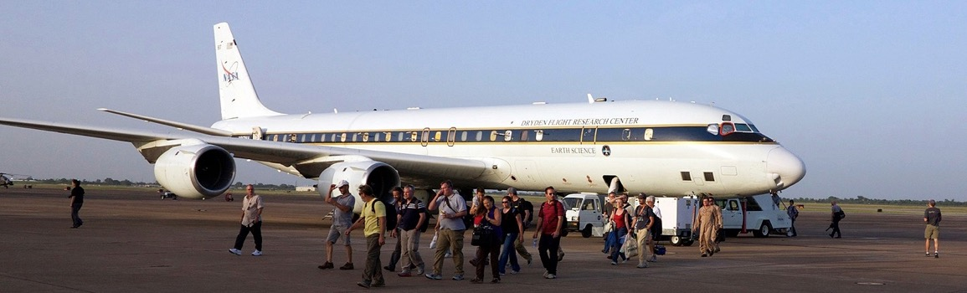

Slide 31
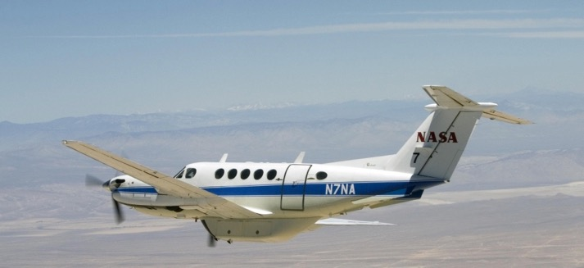
Three B-200 aircraft: NIER, KMA, NASA

Slide 32
Work and Lab Spaces
Office Space (building 1171)
Science team, forecast teams, flight crews, etc.
Power available is 120V/60Hz (on 20A circuits)
If needed, higher amperage can be requested.
Wi-Fi (100Mbs). Is a static IP needed?

Slide 33
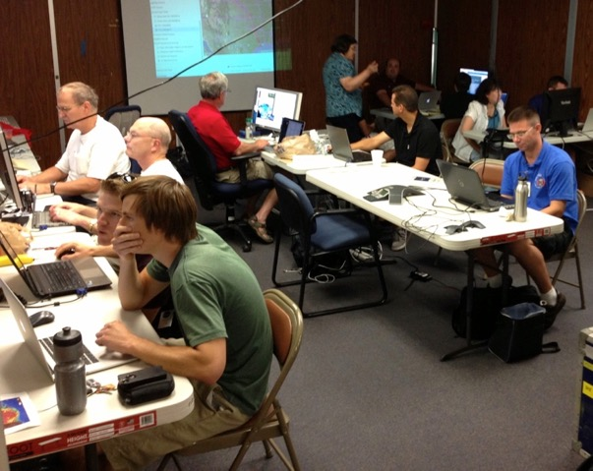
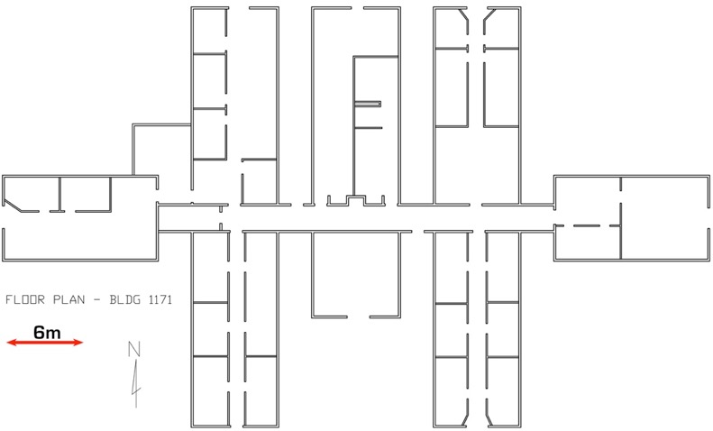

Slide 34

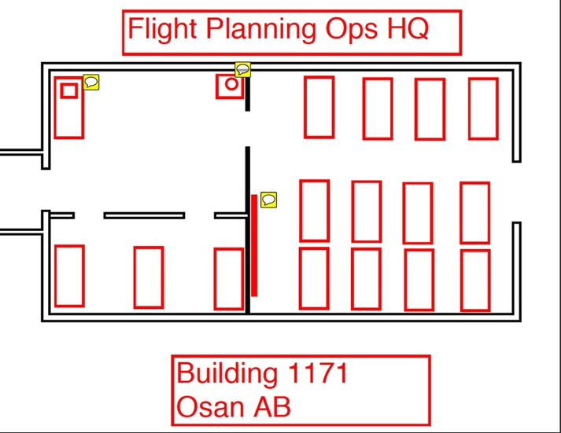
Office Area
Notes:
Office/operations area (building 1171): Located inside gated area. Need to provide some furniture, setup internet, minor repairs.

Slide 35
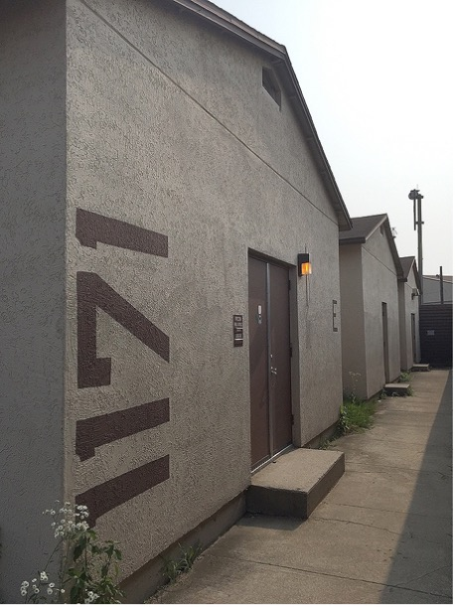
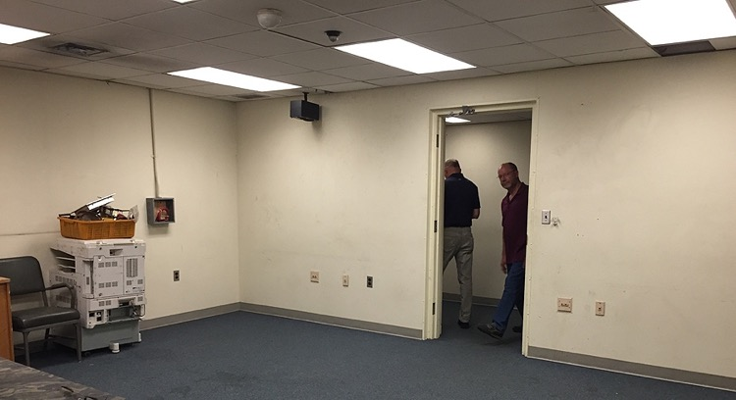
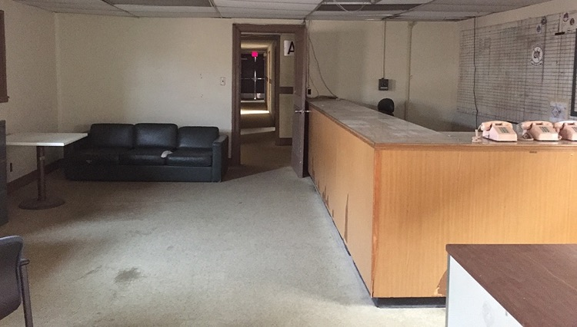
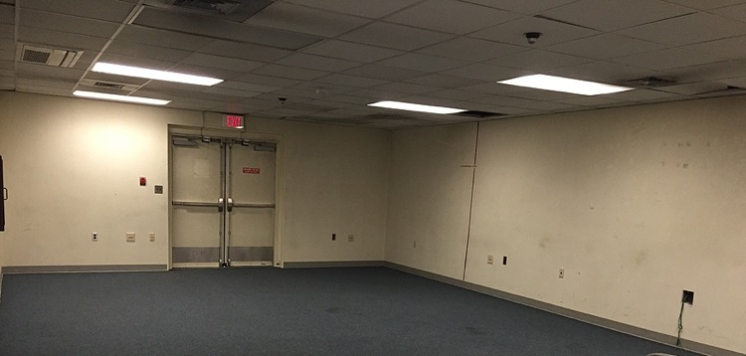
Notes:
Office/operations area (building 1171): Located inside gated area. Need to provide some furniture, setup internet, minor repairs.

Slide 36
Work & Lab Spaces
Hangar Space (building 1187): Instrument Work
Closest proximity to DC-8
No air conditioning
Power available is 120V/60Hz (on 20A circuits)
If needed, higher amperage can be requested.
Wi-Fi (100Mbs). Is a static IP needed?

Slide 37
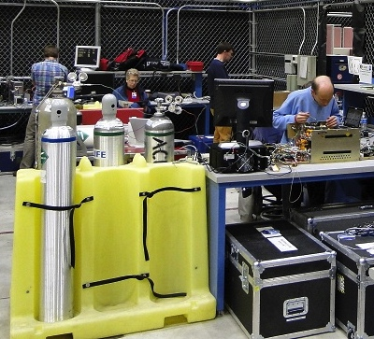
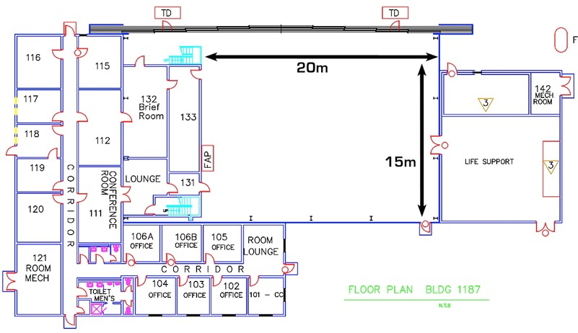

Slide 38
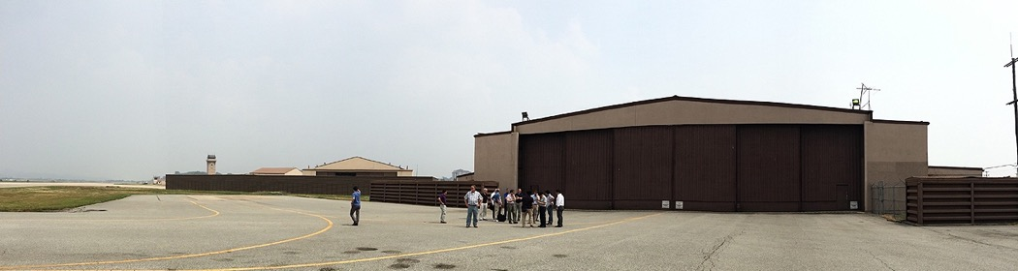
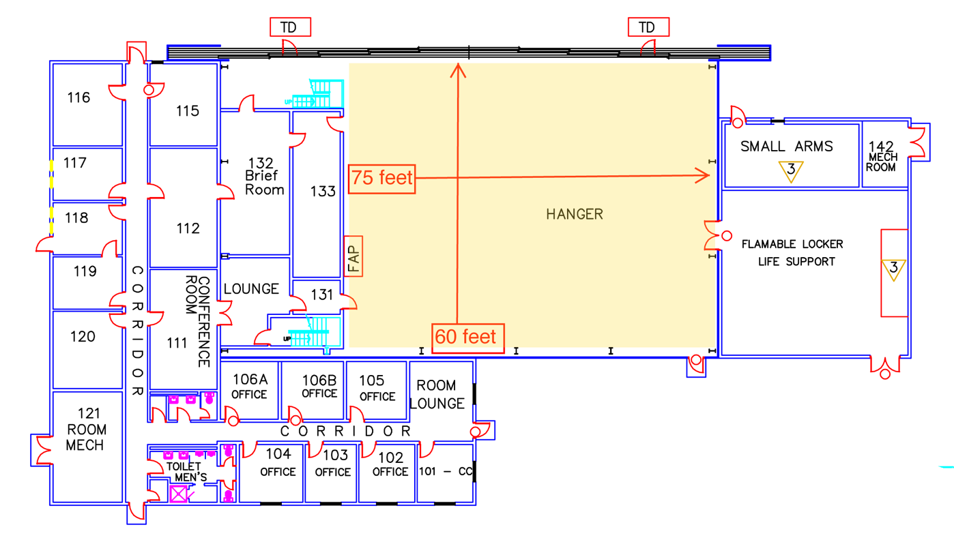
Lab Area
Work/Lab area in Yellow
Notes:
Office/operations area (building 1171): Located inside gated area. Need to provide some furniture, setup internet, minor repairs. No Airconditioning in hangar bay.

Slide 39
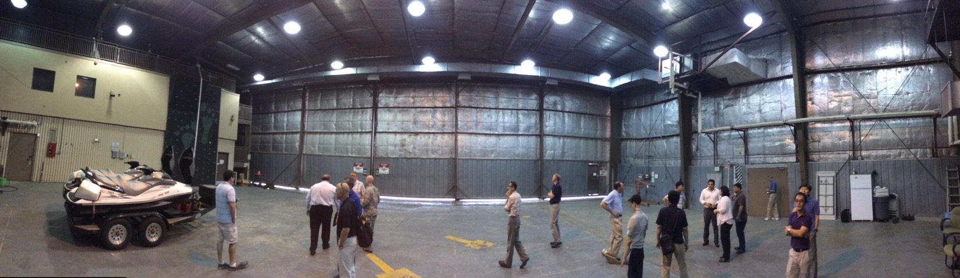
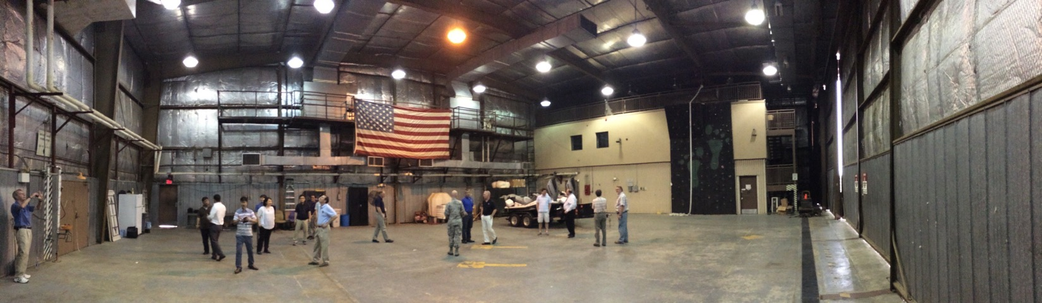
Notes:
Office/operations area (building 1171): Located inside gated area. Need to provide some furniture, setup internet, minor repairs.

Slide 40
Shipping
Shipping Point of Contact Information
Steven Todorov
Earth Science Project Office
Steven.m.todorov@nasa.gov
(650) 996-9335

Slide 41
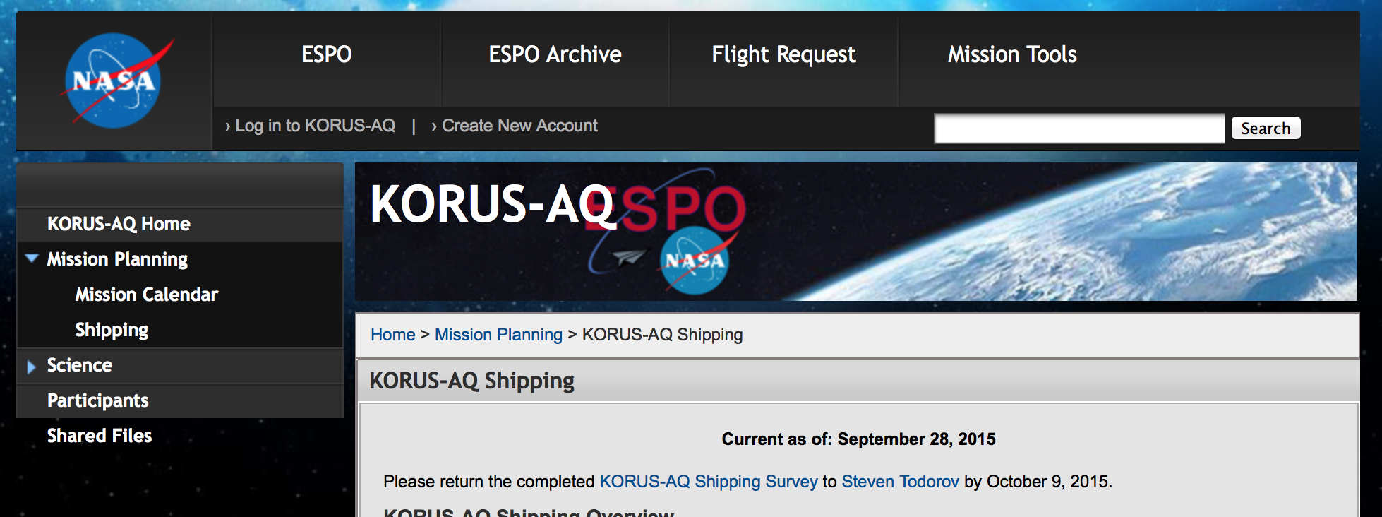
KORUS-AQ Mission Website
Central Clearinghouse for ALL Shipping Logistics

Slide 42
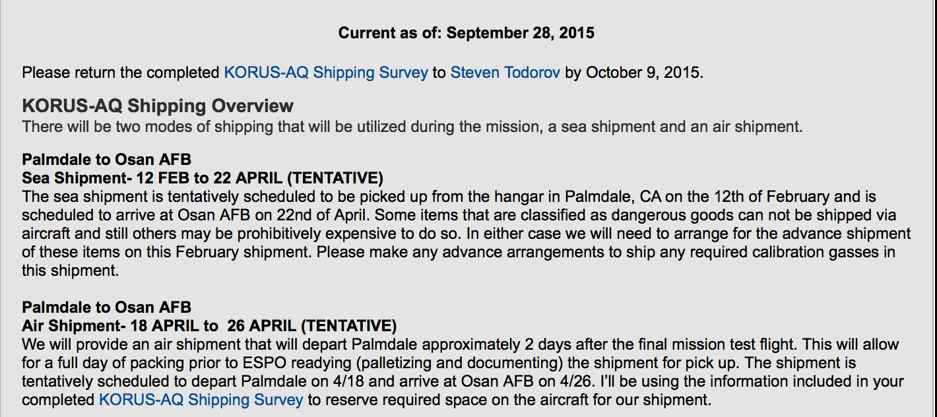
KORUS-AQ Mission Website
Central Clearinghouse for ALL Shipping Logistics
Contact Info
Tentative Shipping Dates
Final Dates are based on not yet published schedules
Shipping Survey
Please see me

Slide 43
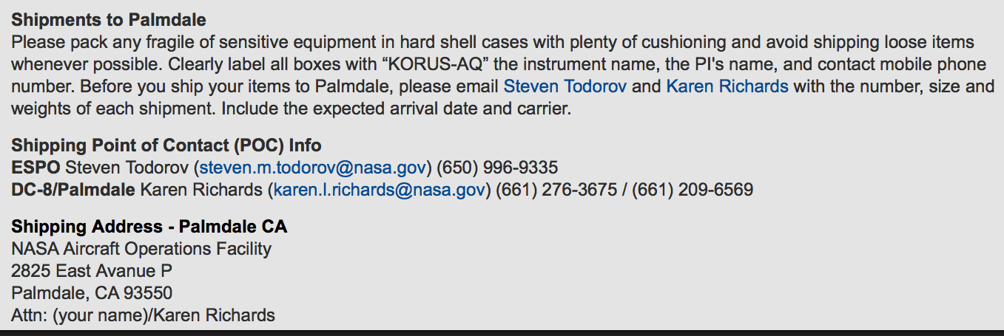
KORUS-AQ Mission Website
Central Clearinghouse for ALL Shipping Logistics
Shipping to the Integration Site
Shipping POC Info
Contact both Karen and Myself in advance of your shipment to PMD
PMD Shipping Address

Slide 44
KORUS-AQ Shipping Plan
2 Modes of Shipping
Sea Shipment
Late February 2016
Air Shipment
After final check flight

Slide 45

KORUS-AQ Shipping Plan
Sea Shipment
Haz Mats
-Gasses
-Chemicals
Equipment not needed for integration

Slide 46
KORUS-AQ Shipping Plan
Sea Shipment
Tentative Shipping Schedule
Haz Mats at PMD no later than 2/14
Non- Haz Mats at PMD no later than 2/22
Arrival at Osan Air Base
7-10 days in advance of 1st possible science flight

Slide 47

KORUS-AQ Shipping Plan
Air Shipment
Instrument support equipment, spares…
Calibration Gasses*
*Haz Mats will be segregated from general cargo

Slide 48
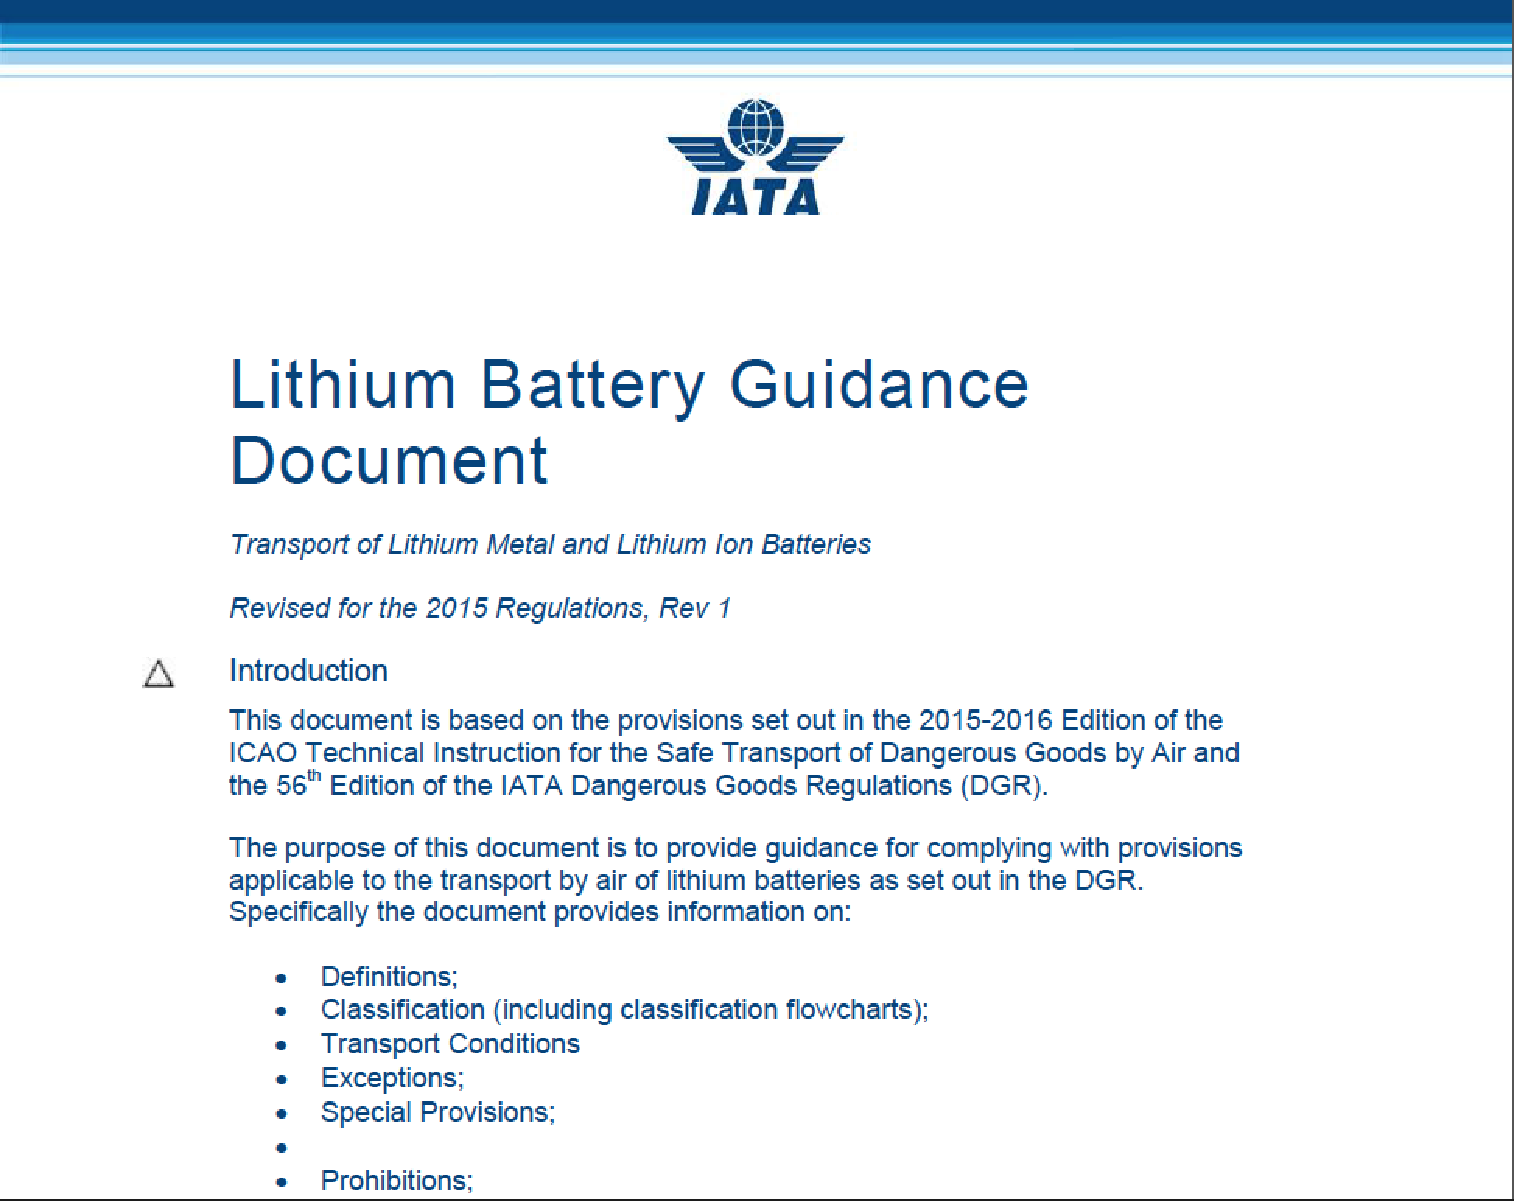

KORUS-AQ Shipping Plan
Air Shipment
Lithium Ion Batteries are being very closely monitored by the aviation industry.

Slide 49


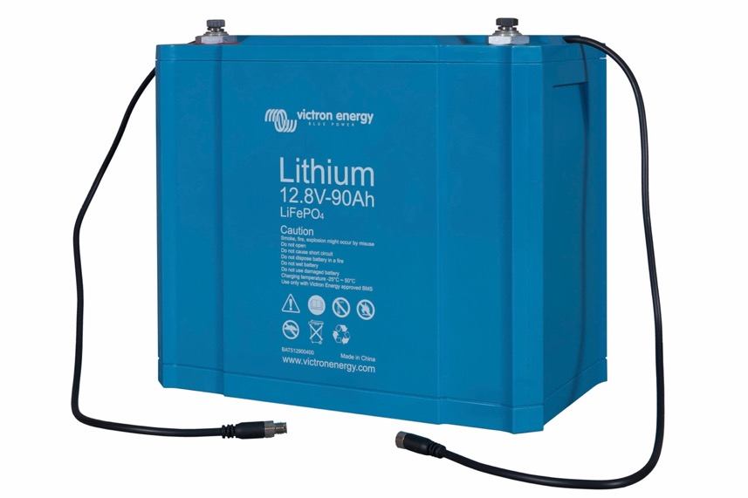



KORUS-AQ Shipping Plan
Air Shipment – Lithium Ion Batteries
Regulations are based on watt hour specs and packaging

Slide 50
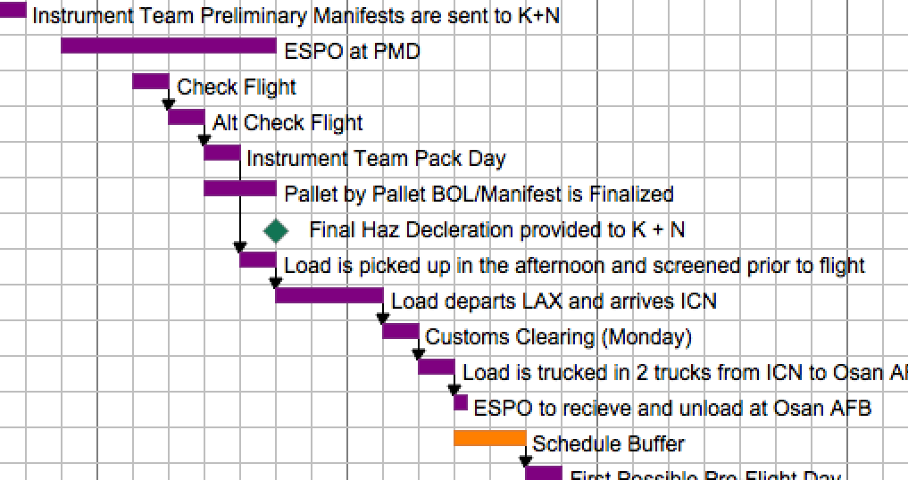
Air Shipment - Timeline
Minimum 7 days from the “pack day” to receipt of delivery at Osan Air Base

Slide 51
Air Shipment - Timeline
In order to make this schedule, our paperwork needs to be complete

Slide 52
Air and Sea Shipment
Export Documentation
Detailed Manifest of Items Being Shipped
Description of the Item
Handheld Osciloscope
Manufacturer
Tektronix
Model Number
THS720A
Serial Number
B011028
Country of Manufacture
USA
Quantity Item
2
Unit Value
$500
Total Value (Qty X Unit Value)
$1,000

Slide 53
Without this…
EXAMPLE INSTRUMENT TEAM
Box # | Description | Manufacturer | Model Number | Serial Number | Country Manufact | Unit Value | Qty | Total Value
2 | Laptop Computer | Toshiba |  | 74333746KU | USA | $1,593 | 1 | $1,593
2 | Monitor | Asus | VE228H- | C7LMQS184841 | USA | $154 | 1 | $154
2 | Monitor | Viewsonci | 24AS485 | Q78084780337 | USA | $146 | 1 | $146
2 | Mini Computer | Dell | KJU458K659 | 23200160JEBC | USA | $739 | 1 | $739
2 | Miscellaneous Computer Cables | NA | NA | - | USA | $100 | 1 | $100
2 | Hand Tool Kit | NA | NA | - | USA | $1,500 | 1 | $1,500
2 | Miscellaneous Spares (Small Fittings andParts) | NA | NA | - | USA | $2,000 | 1 | $2,000
2 | Laptop | Dell | DL564 | E5540 | USA | $1,679 | 1 | $1,679

Slide 54
You won’t get this…

Slide 55

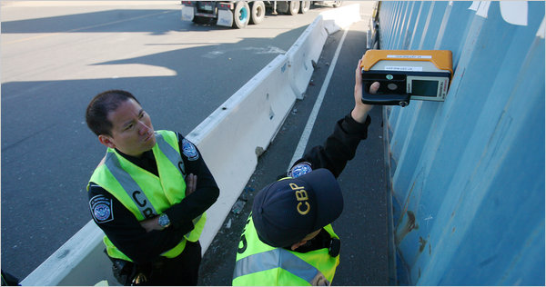
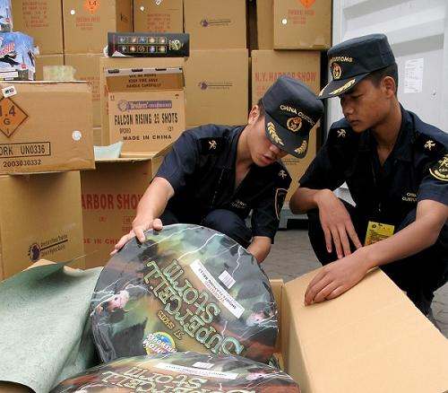
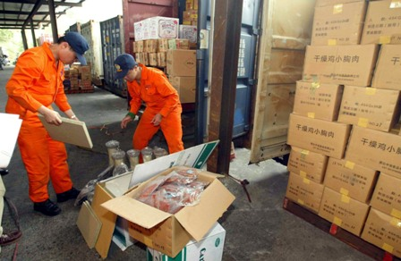
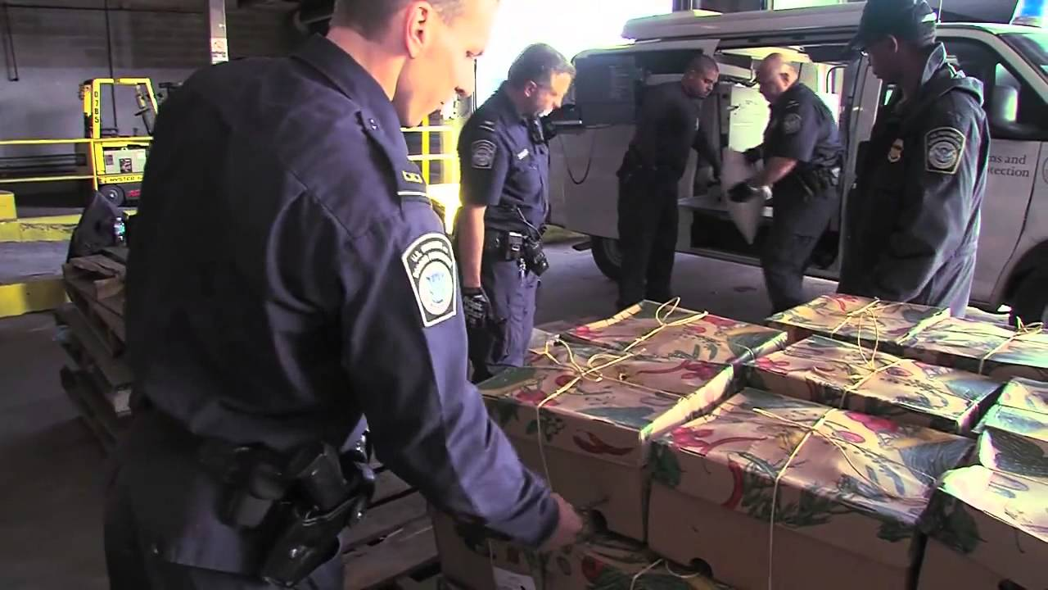
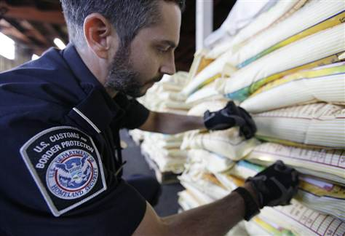
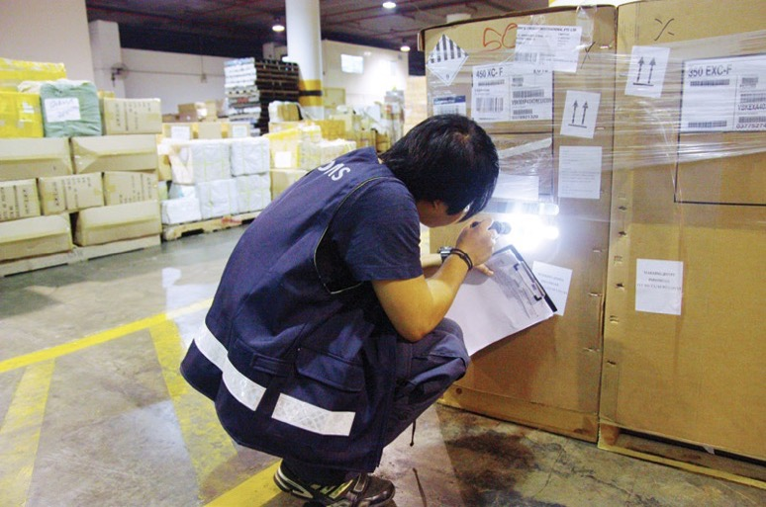
Instead you’ll get this…

Slide 56
Local Gas Provider (Praxair)
ESPO is planning to supply:
Dry Ice
Liquid Nitrogen (LN2)

Slide 57
Steven Todorov
Earth Science Project Office
Steven.m.todorov@nasa.gov
(650) 996-9335

