Slide 1
NURTURE Field Data Repository www-air.larc.nasa.gov Introduction dataID Registration and Data Upload
Michael Shook (michael.shook@nasa.gov)
Gao Chen (gao.chen@nasa.gov)
Ali Aknan (ali.a.aknan@nasa.gov)
Morgan Silverman (morgan.l.silverman@nasa.gov)
Crystal Gummo (crystal.gummo@nasa.gov)

Slide 2
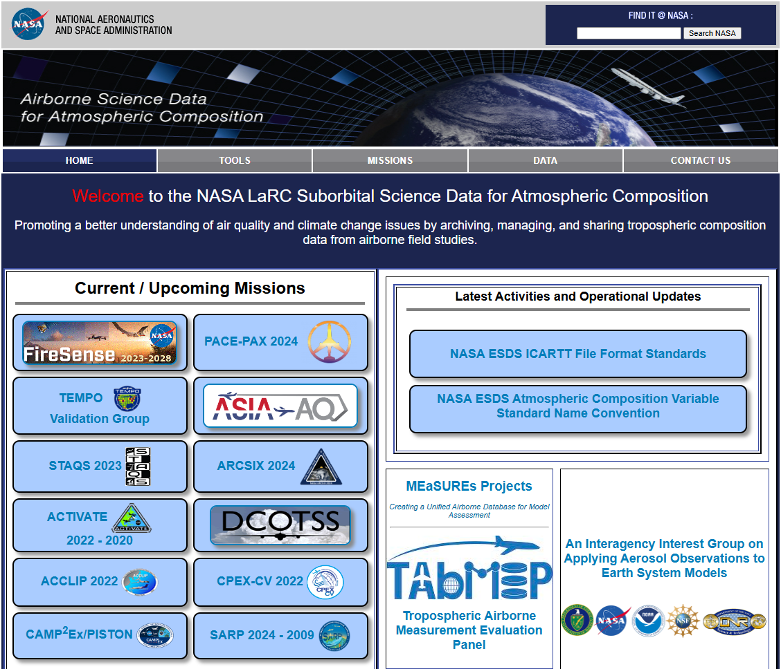
Field Data Repository Introduction
https://www-air.larc.nasa.gov/missions/nurture/
Used for WH2yMSIE, CPEX-CV, FIREX-AQ, CAMP2Ex, and many other NASA field campaigns
A repository for all NURTURE-relevant observational and ancillary data products and relevant documentation/reports to facilitate science team data exchange and data processing
Data holdings include aircraft data as well as other data as needed/requested
Data file types include binary (HDF/netCDF), text (ICARTT), and image (jpg/png)
Password-protected document and file sharing
Publication-quality (“final”) data will be transferred to the HQ-assigned NASA DAAC

Slide 3
NURTURE Data Flow
Data and
metadata
Publication-quality
data and metadata
NURTURE
Science Team
NURTURE Field Data Repository
NASA Data Centers
(DAACs)
File format feedback
Metadata requests
Share understanding on data and science
Applies to NASA campaign data – links provided to collaborator data (including complementary campaigns)
NASA “Facility Instruments” follow a separate process

Slide 4
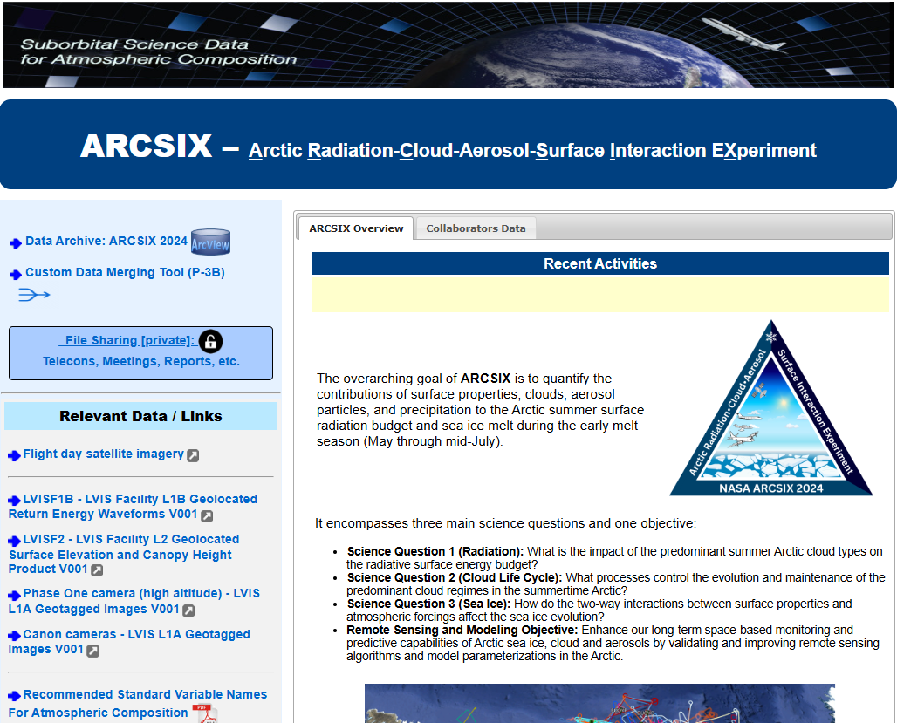
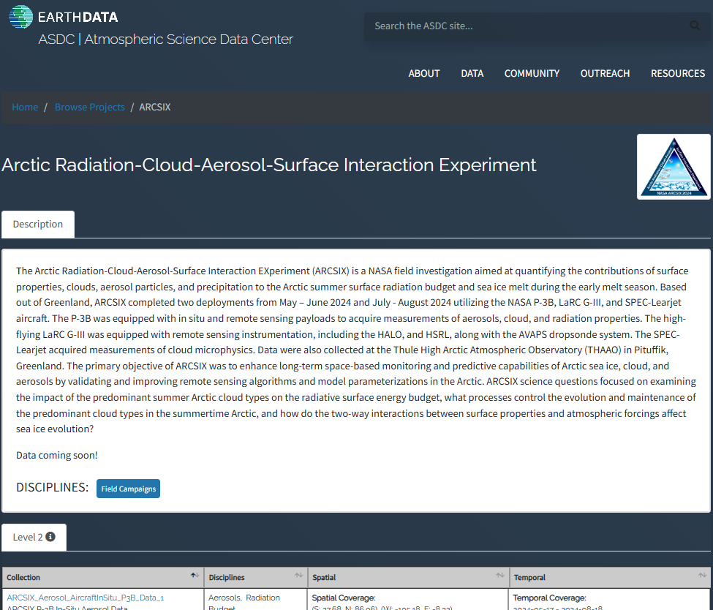
NURTURE Data Flow
NURTURE Field Data Repository
NASA Distributed Active Archive Centers (DAACs)
Roles
Support the NURTURE science team (e.g., facilitate data processing)
Assist with data transfer to the NASA data centers (DAAC)
Continue to accept data revisions
Publicly host data until it is available at a data center (always available to science team with access control)
Roles
Support post-project data discoverability, access, and distribution
Provide long-term preservation and stewardship
Monitor and archive the latest versions of publication-quality data from field data repository
Create data DOIs and dataset citations

Slide 5
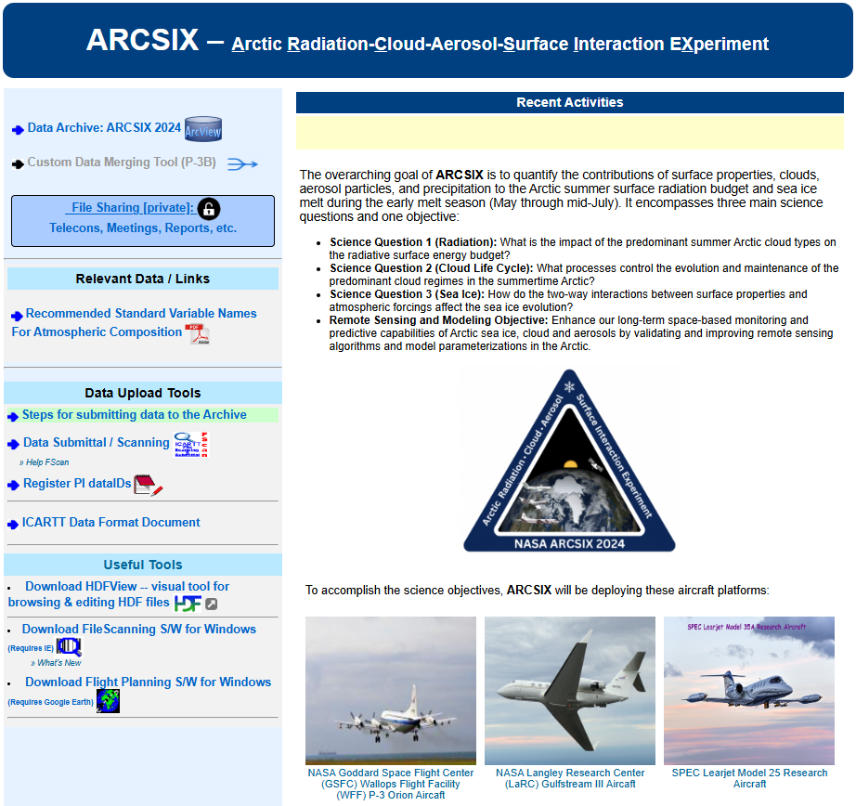
ARCSIX Repository Example
Data Access
Document Upload/Download
DataID Registration
and Data Upload
Script-based tool for large file (i.e., 2 – 25 GB) upload

Slide 6
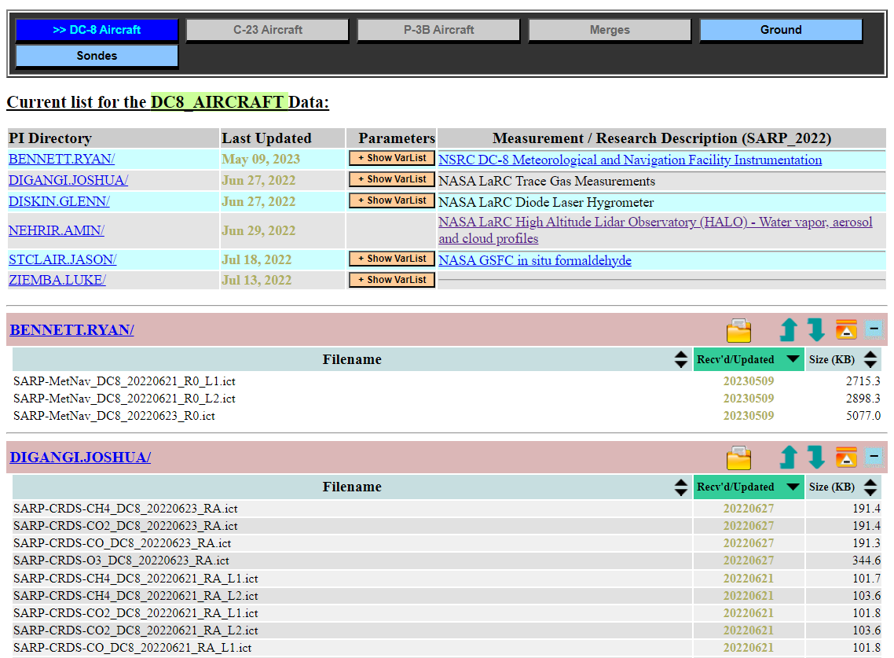
Data Access: SARP Example
Data Organization:
locationID (Platform)
Principal Investigator
dataID (identifier)
Flight or data collection dates
Revision number (version control)
Launch number

Slide 7
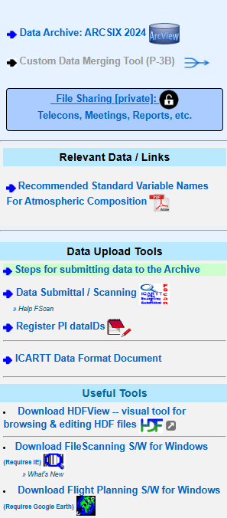
Data Submission Steps
DataID Registration (one-time process):
dataID is part of the filename and will be used to organize PI files on the data repository (links data files to PI)
PI or file creator will need to first register dataID(s) before files can be submitted
Data Submission:
File submission is through a scanning tool (FScan) for checking filenames and content
All incoming files are scanned:
ICARTT Files: file header, including keywords and data flags, as well as time stamps
HDF and netCDF files: data variable dimensions and attributes
Other files: file names
Support zipped multi-file upload
Script-based batch upload and download available
Username/password: contact POCs

Slide 8
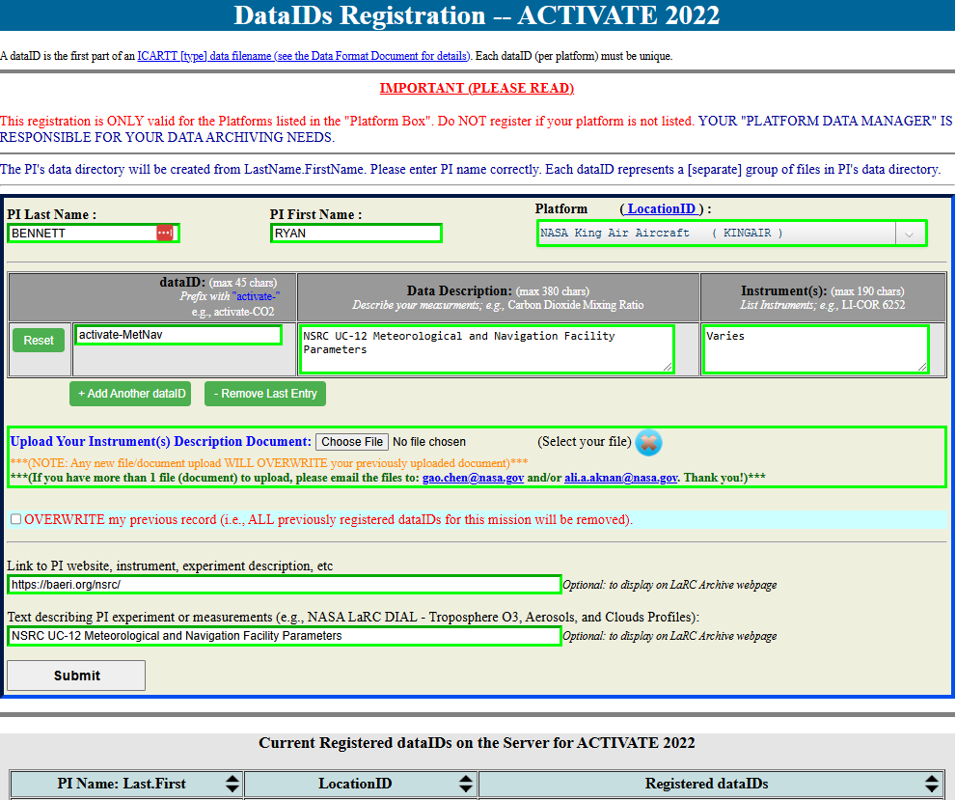
DataID Registration Page
See file naming convention slide

Slide 9
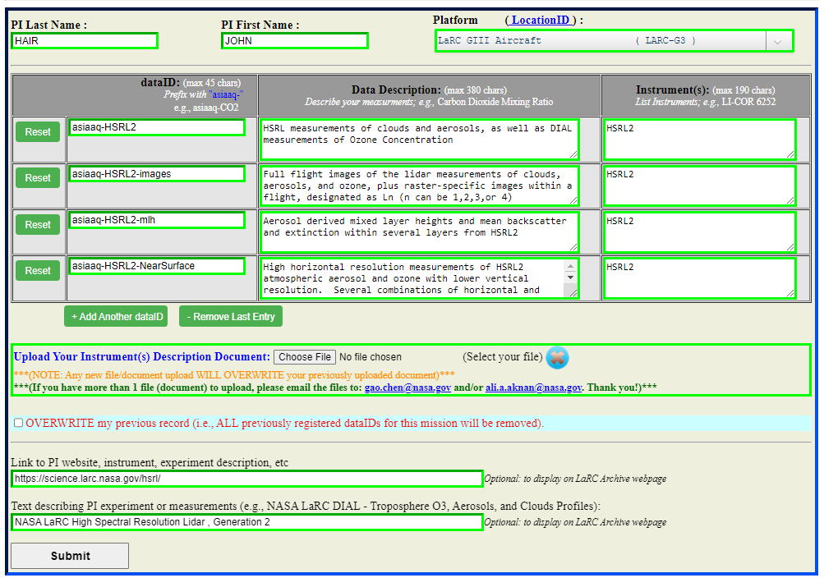
Registered DataID Example

Slide 10
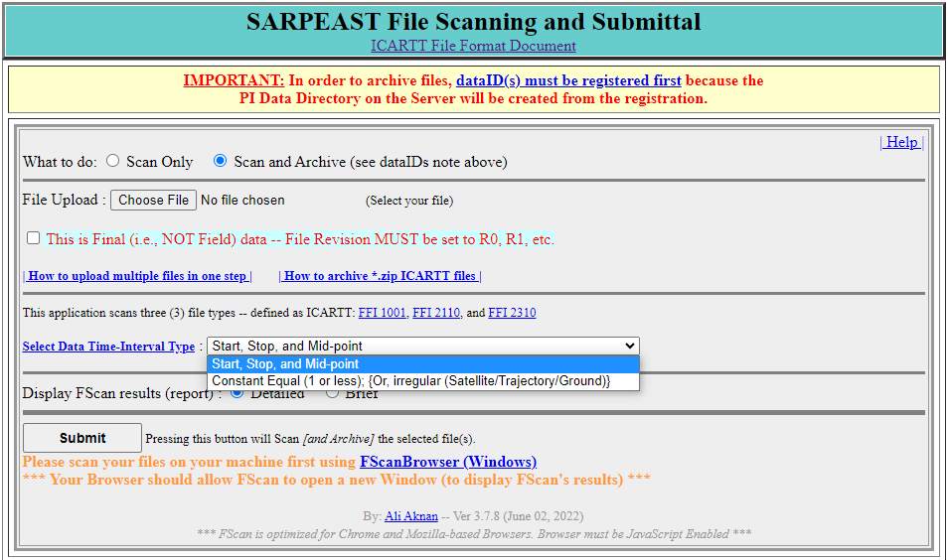
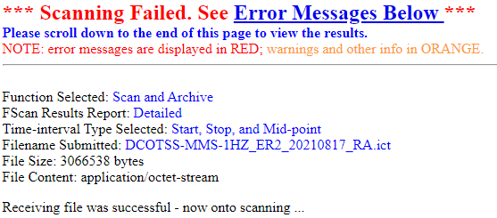
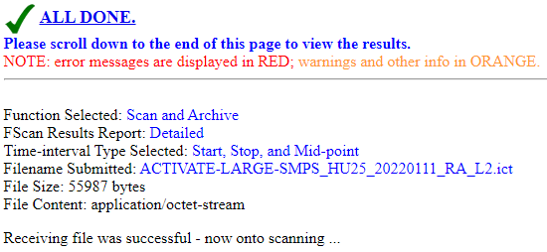
FScan Page
Note: results open on a separate page, may need to change browser permissions

Slide 11
NURTURE File Naming Convention
DataID_LocationID_YYYYMMDD_R# [_Description].extension
DataID: a short description of measured parameter/species, instrument, or model prefixed by “NURTURE-”
LocationID: an identifier of measurement platform/type, provided on the dataID registration website in a drop-down box
NURTURE locationIDs: GIII, B777, SATELLITE, GROUND, MERGE, MODEL, ANALYSIS, TRAJECTORY, SONDE, and OTHER; please reach out if others are needed
YYYYMMDD: UTC date of takeoff for flight data or the beginning of the measurement for ground sites Note: Goose Bay (AST) = UTC-4
R#: Revision identifier for version control. Typically RA, RB, RC, … for field data and R0, R1, R2, … for the publication quality data. Note: archived files cannot be overwritten, only replaced with subsequent revisions
Description: optional additional description of the file if necessary
Extension: “ict” for ICARTT files, and “h5” for HDF 5 files, nc for netCDF files, etc.
Allowed: *.ict, *.nc, *.cdf, *.hdf, *.h4, *.h5, *.hdf4, *.hdf5, *.he5, *.kmz, *.kml, *.htm, *.html, *.txt, *.jpg, *.jpeg, *.gif, *.png, *.bmp, *.pdf, *.xls, *.xlsx, *.doc, *.docx, *.ppt, *.pptx
Upon request: *.zip, *.tar, *.gz, or others
The underscore, “_”, is used ONLY to separate the different fields of the filename
Examples: the filename for NURTURE DLH measurement made on a December 15, 2026, flight may be:
NURTURE-DLH_B777_20261215_RA.ict (for field data)
NURTURE-DLH_B777_20261215_R0.ict (for publication quality data)

Slide 12
NURTURE Data Submission Schedule
Mission Phase | Data Type | Submission Deadline | Access Control
Field Deployment | Field Data | Typically 24 hour after each flight or cal. Day | Science team and Partners
Post-Deployment | Publication-quality or “Final” Data | 6 months after campaign concludes | Public
Field data submission deadline may vary depending on field operation constraints
The final data should be of publication quality and time synced to the time standard for each platform for in-situ measurements

Slide 13
NURTURE Data Format Requirements
The NURTURE data will conform to ICARTT, netCDF, or HDF format standards. This supports NASA’s Open-Source Science and Open Data initiatives by making NURTURE data FAIR
All in-situ measurements are required to report data in ICARTT format (https://www.earthdata.nasa.gov/s3fs-public/imported/ESDS-RFC-029v2.pdf)
ICARTT files will be scanned to ensure compliance with the format requirements
HDF and netCDF files should be as CF-compliant as possible, i.e., having all required global and variable attributes and properly dimensioned data variables (template URL to be posted)
Assistance will be available to the science team to troubleshoot file format and submission issues

Slide 14
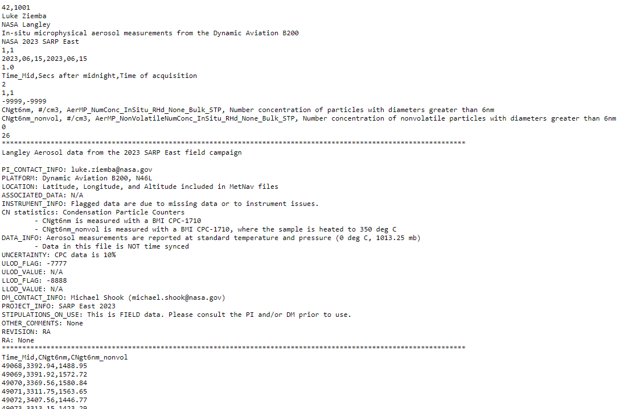
ICARTT Format
CSV text file with prescribed header format
Self-describing (can be read programmatically)
https://www.earthdata.nasa.gov/s3fs-public/imported/ESDS-RFC-029v2.pdf
Number of header lines
Principle Investigator (PI)
Flight date
Independent variable
Missing data flags
Variable definition lines
Metadata (normal header lines)
Data (comma-separated)

Slide 15
NURTURE Data Reporting Best Practices using ICARTT file
For in-situ measurement ICARTT files, please use the same number, names, and order of variables throughout the mission for files within the same dataID and revision.
Measurement Time Reporting in ICARTT files:
Fixed variable name(s): Time_Start, Time_Stop, and Time_Mid
Report start, stop, and mid times if integration interval larger than 1 sec
Can use one time stamp (e.g., Time_Start or Time_Stop) for data at ≥ 1 Hz
Use the ICARTT file header (e.g., DATA_INFO) or metadata to indicate whether the measurement time is synced to the time standard
Report absolute concentrations and aerosol extensive properties at STP: 273.15K and 1013.25 hPa (i.e., 0°C and 1atm)
Clearly indicate if the trace gas measure is respect to dry air or ambient air
Variable short name should not start with a number or contain “-”
Use standard unit notation: WMO Codes Registry : wmdr/unit, adopted by NASA

Slide 16
NURTURE Data Reporting Best Practices using HDF/netCDF file
Use global attributes to describe data, data file, data source (e.g., instrument), data spatial/temporal coverage, data processing and revisions, and contacts
Use dimensions, avoid using fake_dims
Data variables should be properly dimensioned
Variable short name should not start with a number or contain “-”
Data variables need to have “long_name” and “units” attributes
use long_name attribute to define the time stamp is instantaneous, or start, mid, or stop time of the period
Use standard unit notation: WMO Codes Registry : wmdr/unit, adopted by NASA
Use “degrees_north” and “degrees_east” for lat and lon
Data flag variables should have “flag_masks” and “flag_meanings” attributes, instead of “units” attribute
The HDF/netCDF template and checker will be posted on the field data repository
The checker can be configured for specific instrument variable checks

Slide 17
ACVSNC Variable Standard Names
Atmospheric Composition Variable Standard Name Convention (ACVSNC) is a NASA Earth Science Data Systems convention, intended to make data more findable and interoperable, and (re)usable:
https://www-air.larc.nasa.gov/missions/etc/AtmosphericCompositionVariableStandardNames.pdf
Applicable to geophysical variables or level 2 data products
Tags, NOT short names:
For ICARTT files: short name, unit, standard name, long name
CH2O_pptv, pptv, Gas_CH2O_insitu_S_AVMR, mixing ratio by volume
CH2O_LOD_pptv, pptv, Gas_CH2O_insitu_S_AVMR, Limit of Detection
NOy_pptv, pptv, Gas_NOyasNO_insitu_M_AVMR, Total Reactive Nitrogen Mixing Ratio
Sc700_total, Mm-1, AerOpt_Scattering_insitu_red_RHd_Bulk_AMB, Dry Scattering at 700nm (Total Aerosols)
For netCDF and HDF files: use ACVSN_standard_name attribute
Contact Morgan, Gao, or Michael for questions or adding new standard names

Slide 18
WIGOS Measurement Unit Standard
New NASA unit notation standard
Adoption of WIGOS (World Meteorological Organization (WMO) Integrated Global Observing System) Metadata Representation code list for measurement units (https://codes.wmo.int/wmdr/unit)
Intended to make unit notation more (re)usable across data files
Examples:
Water Vapor Mixing Ratio: g.kg-1
U wind speed: m.s-1
Potential Vorticity: K.m2.kg-1.s-1 (i.e., 10⁶ PVU)
Unitless Variables: 1
Contact Morgan or Gao for questions regarding notation
. replaces /

Slide 19
NURTURE Science Data Policy
All participants are requested to accept the following responsibilities:
Submit data in a community-accepted format and follow the data format best practices
Publication-quality or “final” data must be submitted to the data repository prior to any public presentation at scientific conferences (e.g., AGU, AMS) or manuscript preparation
NASA-funded participants need to follow the NASA SMD Science Information Policy (data must be publicly accessible, no exclusive access)
Consult with instrument PIs when using their data in conference/data workshop presentations and/or manuscripts
Invite instrument PIs of any data used to be co-authors
PIs should be available to answer questions about their data. Also, README documents are very helpful!

Slide 20
Points of Contact
Field Repository (www-air.larc.nasa.gov)
Michael Shook, NASA Langley Research Center, michael.a.shook@nasa.gov, 757-864-5793
Gao Chen, NASA Langley Research Center, gao.chen@nasa.gov, 757-759-5642 (cell)
Ali Aknan, AMA/NASA Langley Research Center, ali.a.aknan@nasa.gov (website and file scanner)
Crystal Gummo, AMA/NASA Langley Research Center, crystal.gummo@nasa.gov (website and file scanner)
Morgan Silverman, AMA/NASA Langley Research Center, morgan.l.silverman@nasa.gov (standard name issues)
Please free feel to reach out for data download, upload, format, and ACVSNC standard name issues

Slide 21
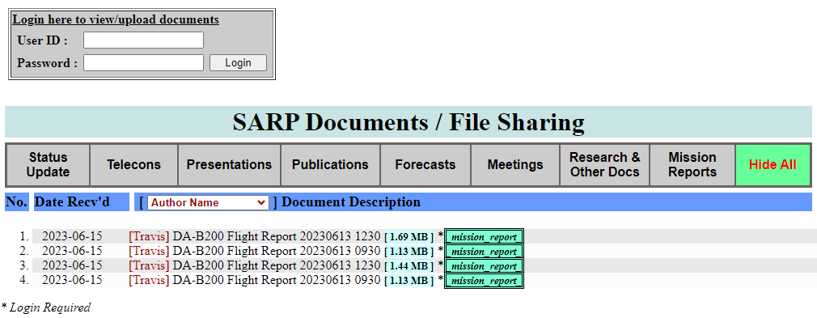
Example Document Sharing Page
https://www-air.larc.nasa.gov/cgi-bin/DocXhg/SARPDocs

Slide 22
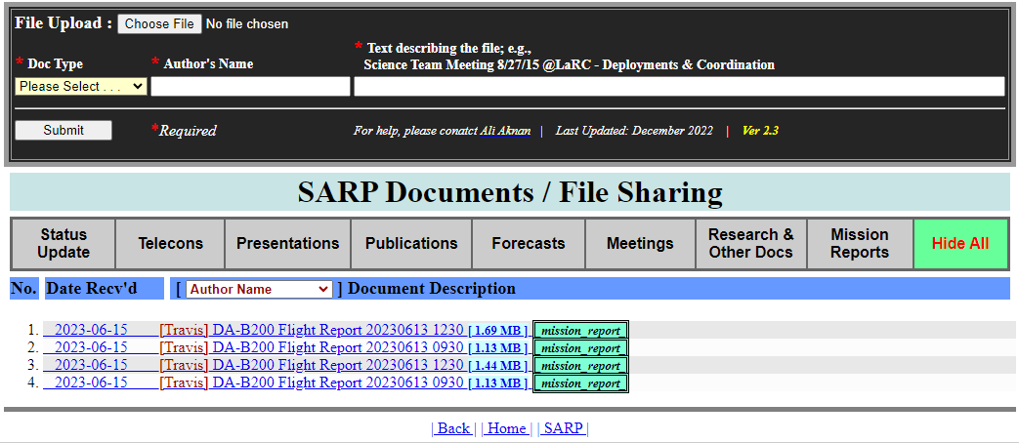
Example Document Sharing Page
https://www-air.larc.nasa.gov/cgi-bin/DocXhg/SARPDocs
File upload process:
Log in
Choose file, document type, author name, and text to appear on the file list
File list is public, but viewing/downloading requires logging in

