Slide 1
TROPOMI & OMI Observations
May 7-May 9, 2019
Figures from: Lok Lamsal & Alex Kaltenbaugh

Slide 2
May 7, 2019
TROPOMI Trop Col NO₂
OMI Trop Col NO₂
* Top 500 2014 NOx-emitting platforms are black points

Slide 3
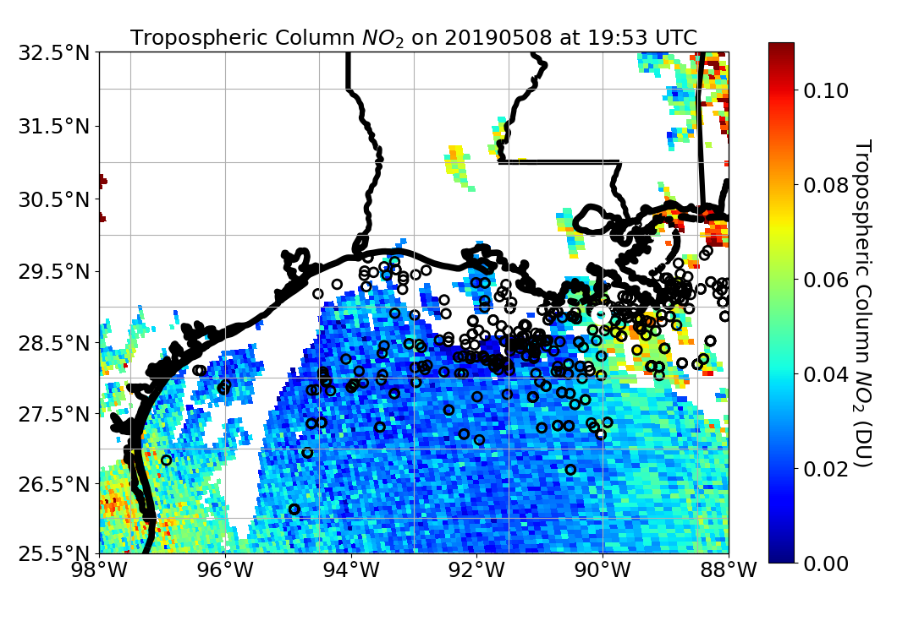
May 8, 2019
OMI Orbit1 Trop Col NO₂
TROPOMI Trop Col NO₂
OMI Orbit2 Trop Col NO₂
* Top 500 2014 NOx-emitting platforms are black points

Slide 4
May 9, 2019
TROPOMI Trop Col NO₂
TROPOMI Trop Col NO₂ Over LOOP
* All 2014 NOx-emitting platforms are black points here and LOOP is white circle.
* Top 500 2014 NOx-emitting platforms are black points

